Slide 1
Day 6: Invasive Species

Slide 2
Habitat alteration causes biodiversity loss
The greatest cause of biodiversity loss
Habitats are destroyed, fragmented, and degraded
Farming simplifies communities
Grazing modifies grassland structure and composition
Clearing forests removes resources organisms need
Hydroelectric dams turn rivers into reservoirs
Suburban sprawl replaces natural communities

Slide 3
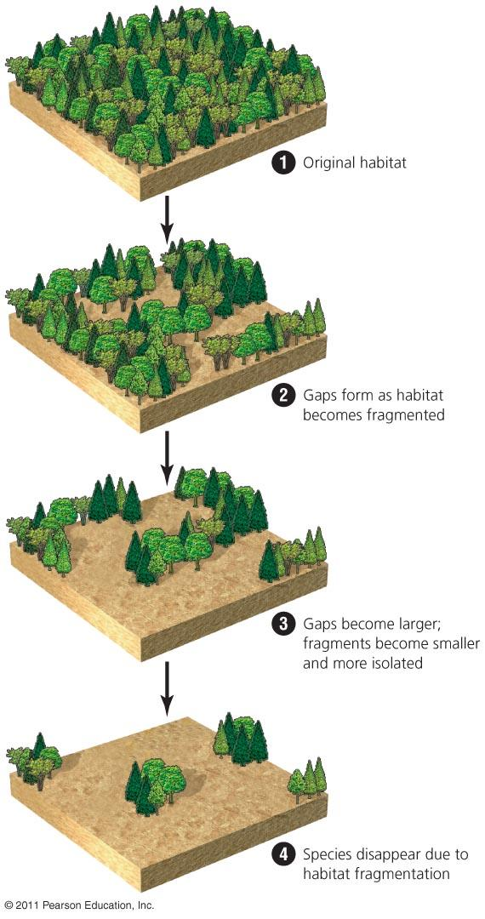
Habitat fragmentation
Habitat fragmentation = Continuous habitats are broken into patches
Farming, roads, logging, etc.
Species needing that habitat disappear

Slide 4
Overharvesting causes biodiversity loss
Vulnerable species: are large or provide food
Large, few in number, long-lived, and have few young
The Siberian tiger & rhinos are hunted without rules and regulations
Powerful economic incentives increase poaching
Many other species are affected
Whales, sharks, gorillas
The oceans contain only 10% of the large animals they once did

Slide 5
Climate change causes biodiversity loss
Emission of greenhouse gases warms temperatures
Modifying global weather patterns
The frequency of extreme weather events increases
Droughts, floods, etc.
Increased stress forces organisms to shift their geographic ranges
Most animals and plants will not be able to adapt
20–30% of species are at increased risk of extinction

Slide 6
Warming has been the greatest in the Arctic
Because of melting ice, polar bears can’t hunt seals, so they were added to the endangered species list in 2008

Slide 7
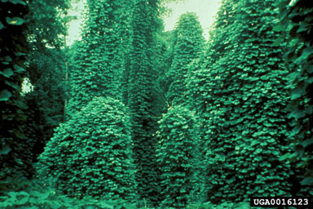
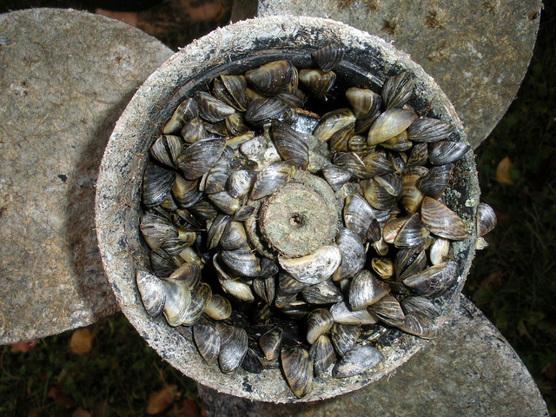
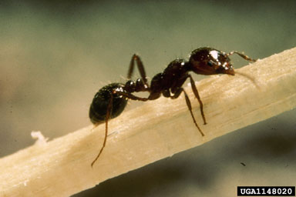
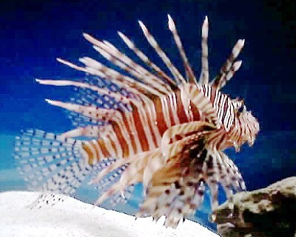
Non-native species
Have no natural enemies so they can thrive in the new ecosystem and crowd out the native species: Examples

Slide 8
Keystone species:
Their strong interactions with other species affect the health and survival of these species
Keystone species:
Pollinate
Scatter seeds
Modify habitats
Predation to control prey populations
Help plants get nutrients
Recycle animal waste

Slide 9
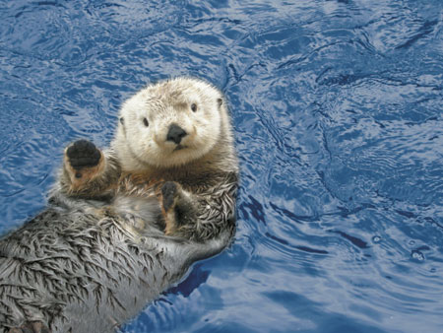
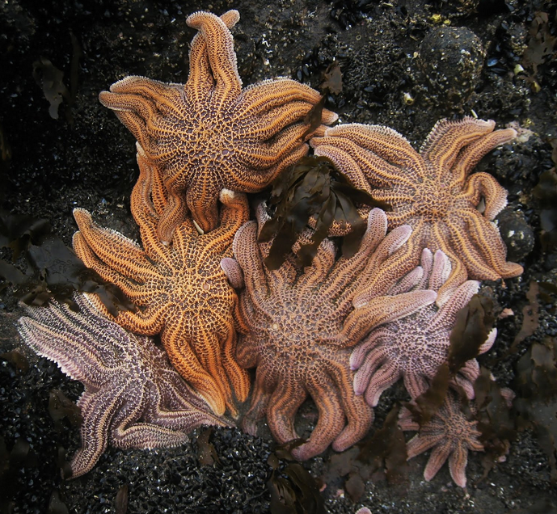
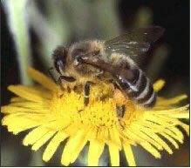
Keystone species:

