Slide 1
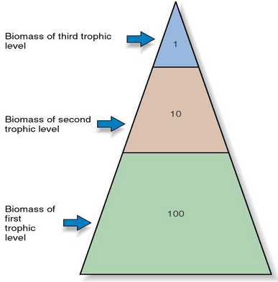
Warmup...
This pyramid shows the ecological “rule of 10”.
a. Why are there less living things at high trophic levels?
b. Why is all the energy in one level not available to consumers in the next level?

Slide 2
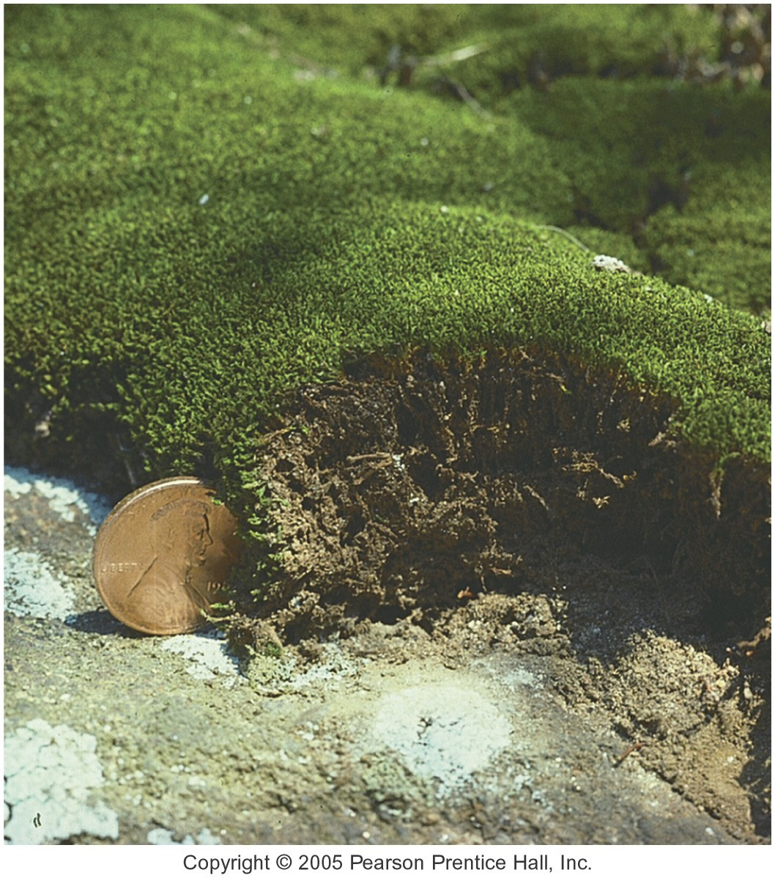
Ecological Succession
Ecological succession: transition between biotic communities
Primary: no previous life
Ex: Newly formed island
Secondary: previously occupied by an ecosystem
Ex: Large forest fire
Aquatic: transition from pond or lake to terrestrial community

Slide 3
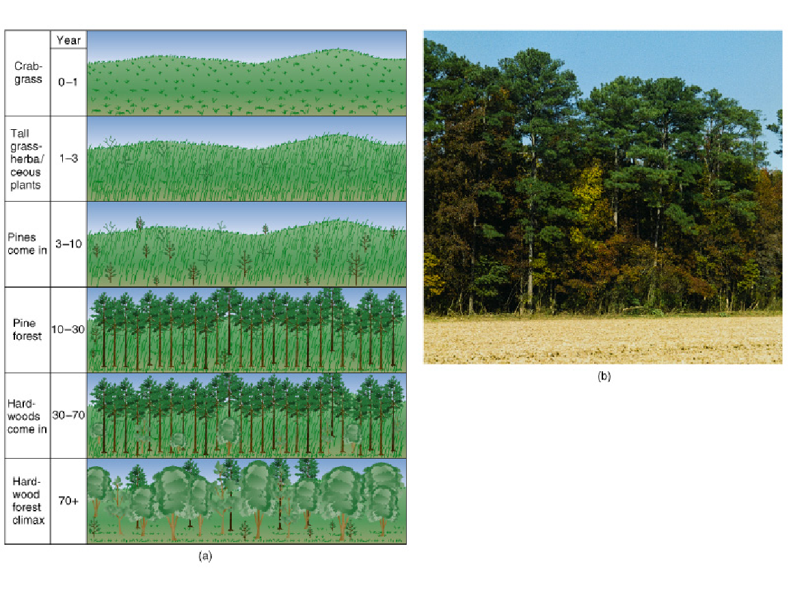
Secondary Succession
Secondary Succession

Slide 4
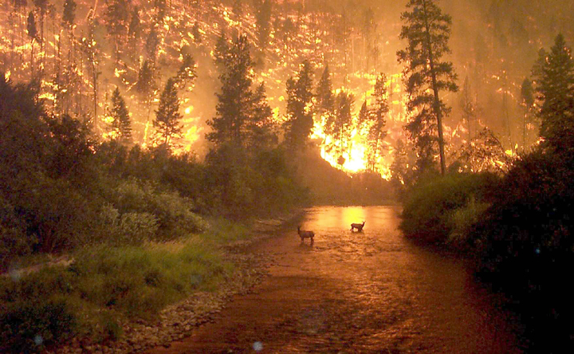
Fire and Succession

Slide 5
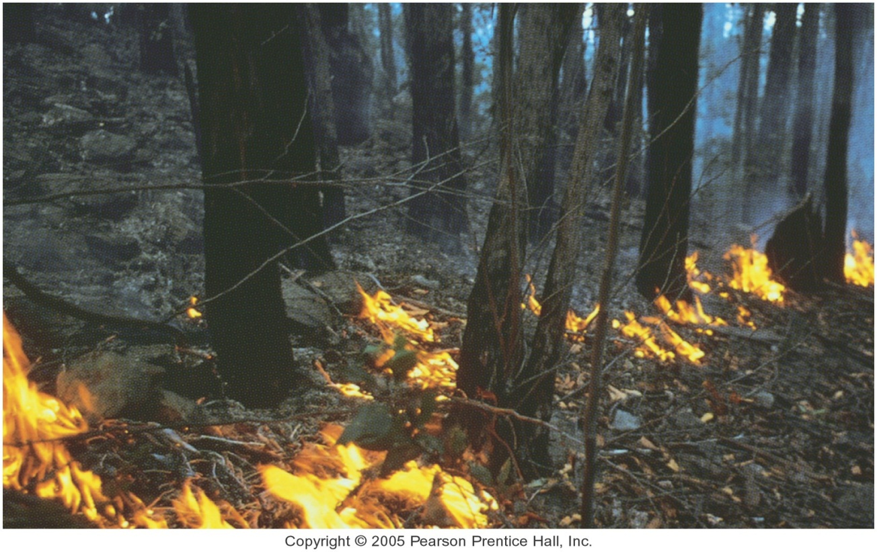
Fire and Succession
Fire climax ecosystems: dependent upon fire for maintenance of existing balance; e.g., grasslands, pine and redwood forests
What significance does this have for humans and where they live?

Slide 6
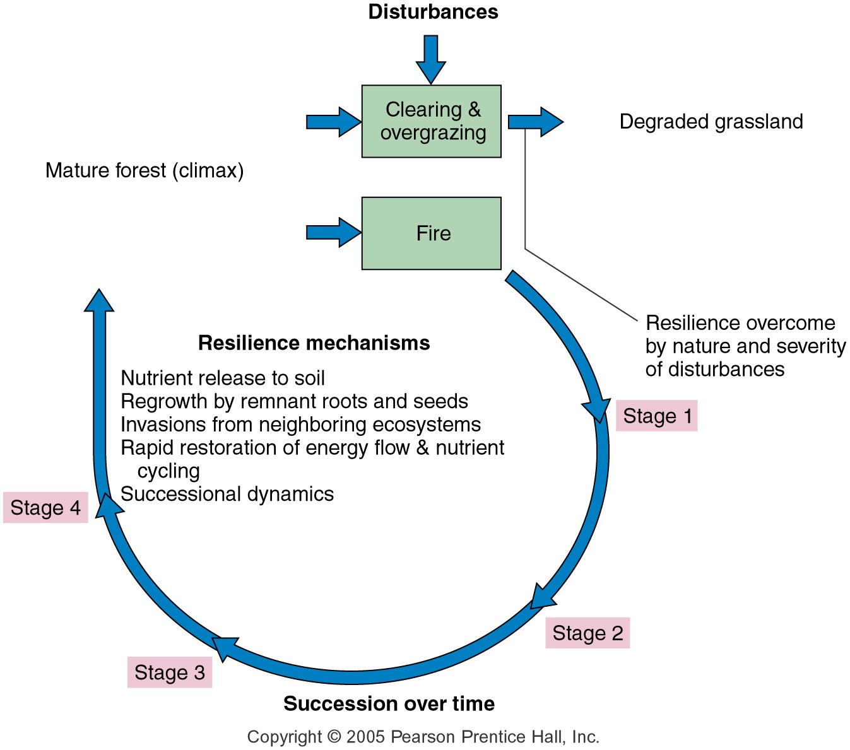

Slide 7
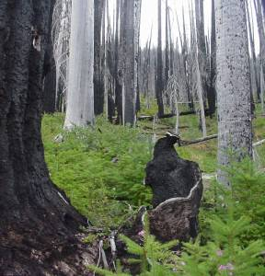
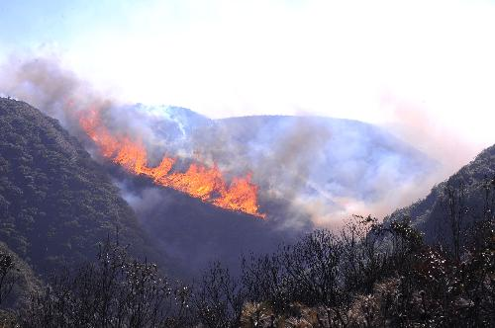
Resilience Mechanisms after a Forest Fire
Nutrient release to soil
Regrowth by remnant roots and seeds
Invasions from neighboring ecosystems
Rapid restoration of energy flow and nutrient cycling

Slide 8
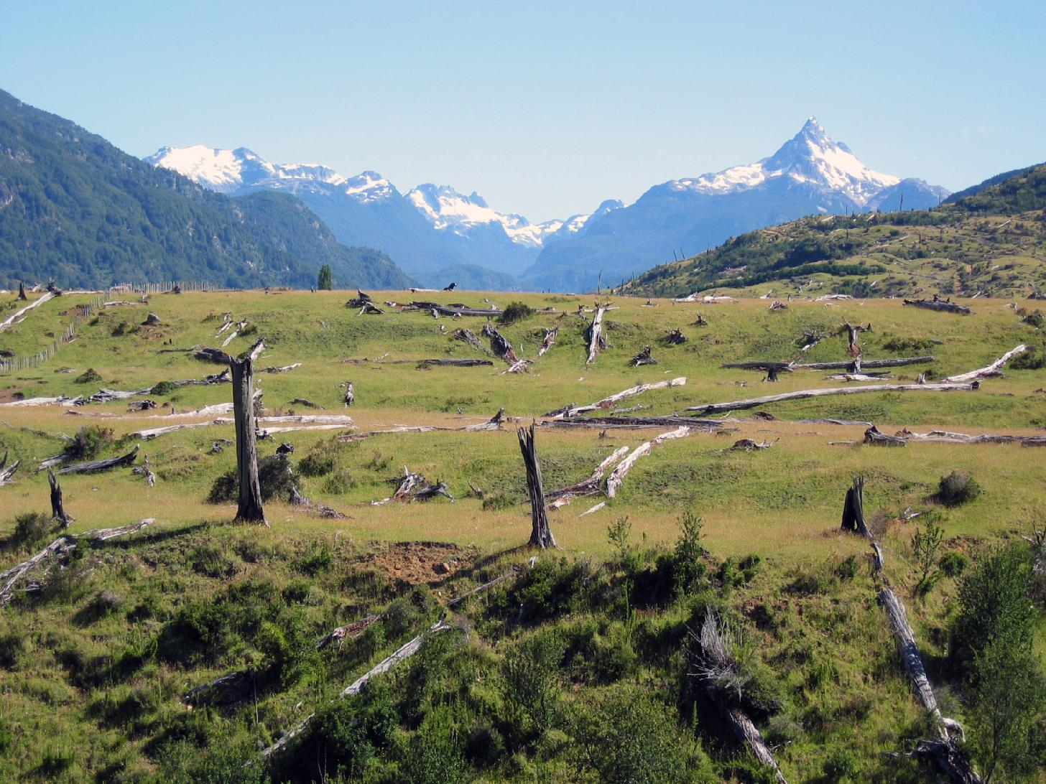
Disturbance and Resilience
Which kind of succession is this?
Removes organisms
Reduces populations
Creates opportunities for other species to colonize

Slide 9
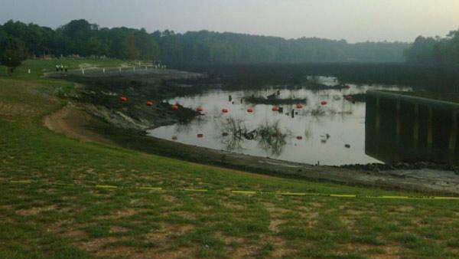
What kind of succession is this?

Slide 10
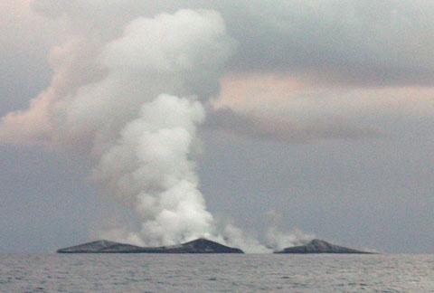
Which kind of succession is this?

Slide 11
Species loss
Extinction: The disappearance of an entire species from the face of the Earth.
Extirpation: The disappearance of a particular population from a given area, but not the entire species globally.
Mass Extinction: The extinction of a large portion of the world’s species in a very short time period due to some extreme and rapid change or catastrophic event. The Earth has seen five mass extinction events in the past half-billon years.

Slide 12
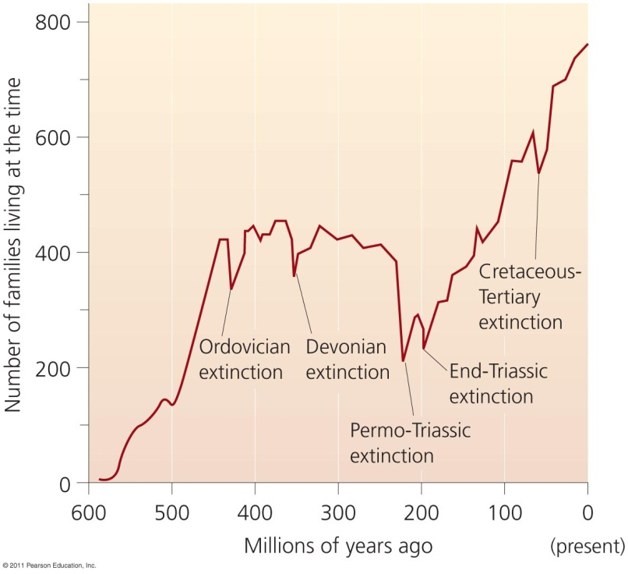
Earth has had five mass extinctions
Earth has had five mass extinctions in the past 440 million years
Each event eliminated at least 50% of all species
Humans are causing this sixth extinction event
We will suffer as a result

Slide 13
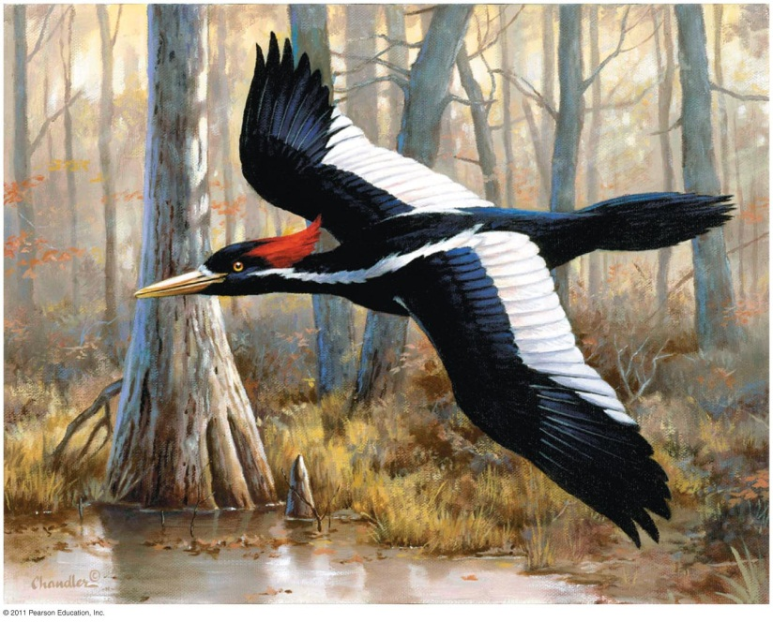
Humans are causing this mass extinction
Humans have driven hundreds of species to extinction
Dodo bird, Carolina parakeet, passenger pigeon
Multitudes of others teeter on the brink of extinction
Whooping crane, Kirtland’s warbler, California condor
The ivory-billed woodpecker may not be extinct

Slide 14
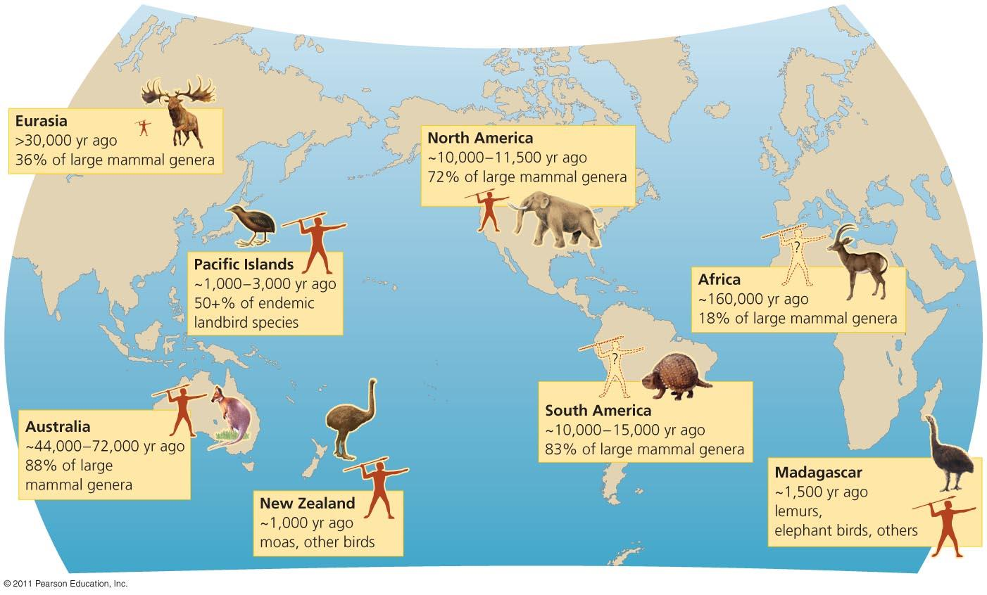
People have hunted species to extinction
Extinctions followed human arrival on islands and continents

Slide 15
Current extinction rates
The current extinction rate is 100 to 1,000 times greater than the background rate
This rate will increase tenfold in future decades
Human population growth and resource consumption
The Red List = species facing high risks of extinction
Mammal species (21%), bird species (12%)
In the U.S., in the last 500 years, 237 animal and 30 plant species have been confirmed extinct
Actual numbers are undoubtedly higher

Slide 16
Evaluate the primary causes of biodiversity loss.
Habitat alteration is the main cause of current biodiversity loss.
Pollution, overharvesting, and invasive species are also import causes.
Climate change is becoming a major cause.
Amphibians are facing a global crisis, probably from a mix of factors.

Slide 17
Biodiversity loss has many causes
Reasons for biodiversity losses are complex and hard to determine
Multiple factors interact in causing losses
Four primary causes of population decline are:
Habitat alteration
Invasive species
Pollution
Overharvesting
Global climate change now is the fifth cause

