Slide 1
Air Pollution Unit
Day 4: Ozone

Slide 2
Air Pollution Sorting Cards

Slide 3
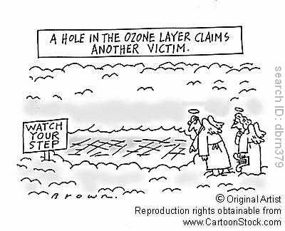

Slide 4
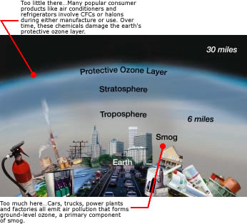
Ozone: The Good and The Bad

Slide 5
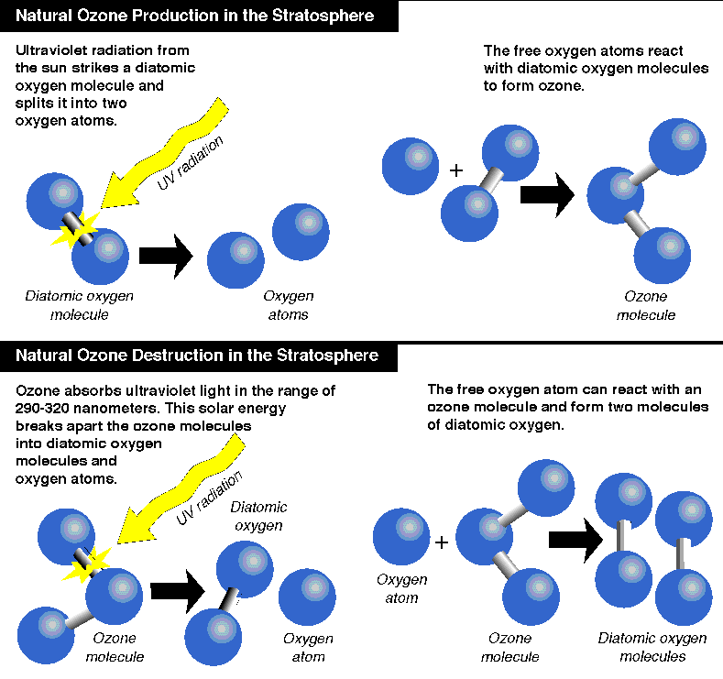

Slide 6
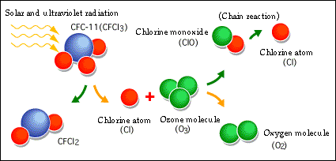

Slide 7
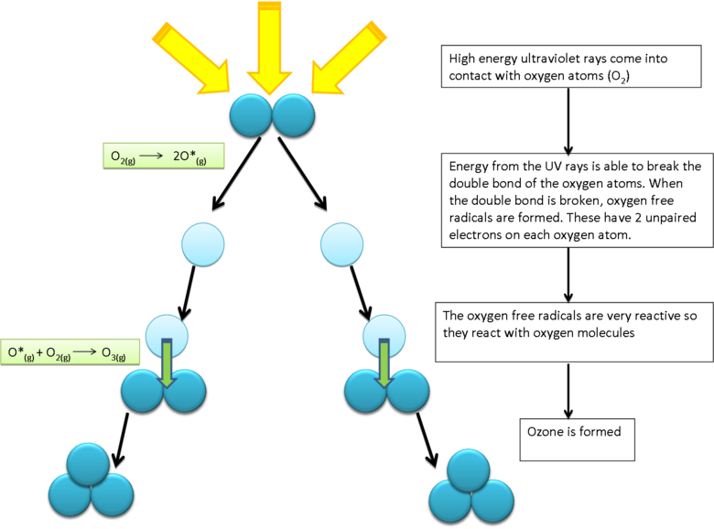
How Ozone is Made

Slide 8
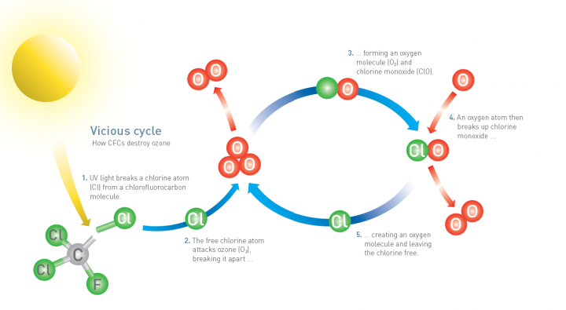

Slide 9
Ozone Science
Two components of ozone depletion
Steady decline 4% per decade since late 1970s
Larger seasonal decline above the poles
Free halogen atoms (The real culprit)
1 Cl atom can potentially destroy 100 000 Ozone mlcs
UVA – UVB (270-315 nm) – UVC

Slide 10
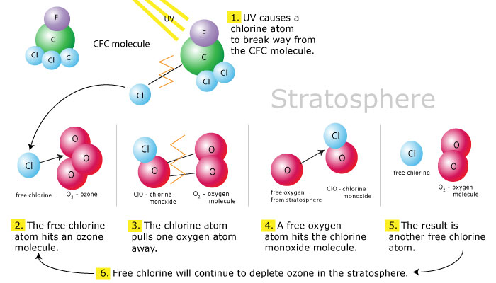

Slide 11
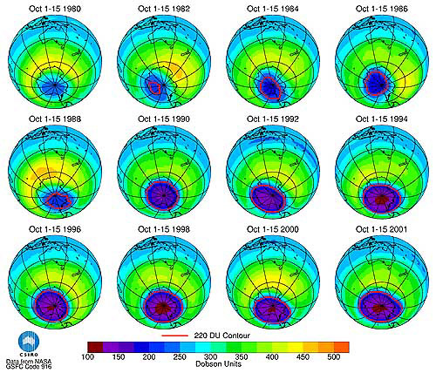
Ozone “Hole” over time

Slide 12
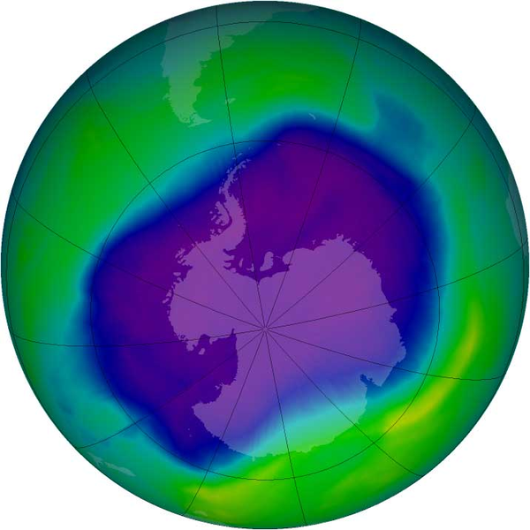
Largest ozone hole to date September 2006

Slide 13
Potential Effects
Increased UV radiation reaching the earth’s surface
Increased incidence of skin cancers
Basal Cell – Squamous cell carcinomas
Malignant melanoma
Cataracts
Repressed Immune Systems
Crop damage (foliage and cyanobacteria)

Slide 14
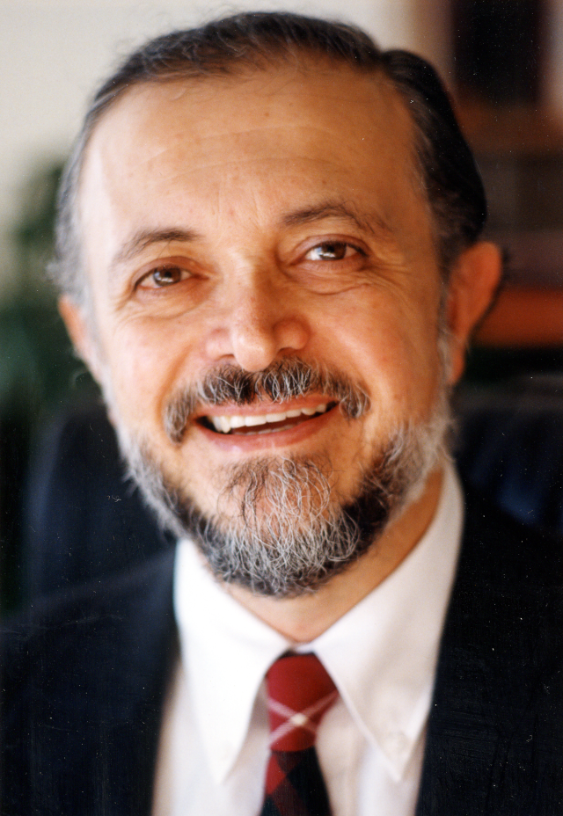
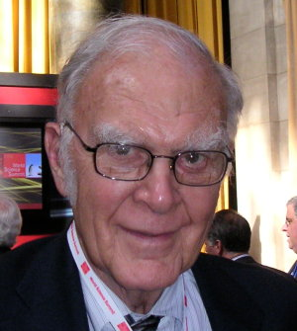
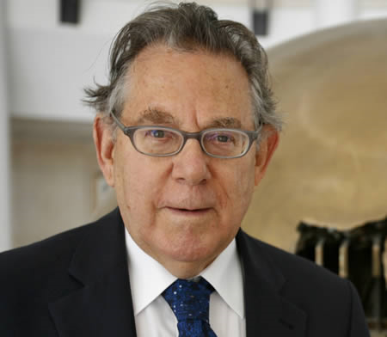
Atmospheric Scientists: 1995 Nobel Prize in Chemistry
Sherwood Roland
Mario Molina
Paul Crutzen

Slide 15
The Montreal Protocol - 1987
International treaty designed to protect the ozone layers
Phase out the use of chemicals that deplete the ozone layer
Played a major role in slowing the destruction of the ozone layer.

