Slide 1
Communities & Food
Day 3

Slide 2
Food For Thought...
We're made of star-stuff. We are a way for the cosmos to know itself.

Slide 3
Sunlight is the main source of energy for all life on earth
Organisms that capture sunlight to produce their own food use photosynthesis
Because they produce their own food they are also called Producers
What are some examples of producers?
In the tropical rain forest?
In your backyard?
In the desert?
In the Ocean?

Slide 4
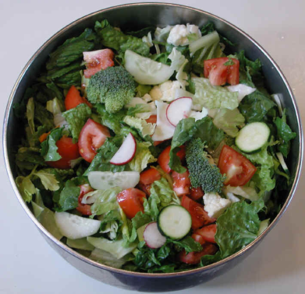
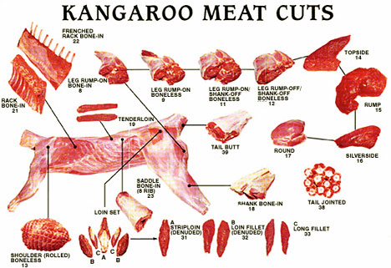
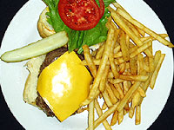
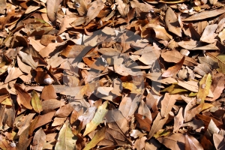
Many organisms DO NOT produce their own food and must consume other organisms to survive
Because they consume other living things these organisms are called consumers
Herbivores
Carnivores
Omnivores
Decomposers
Eat Plants Only
Eat meat only
Eat dead organic material
Eat both

Slide 5
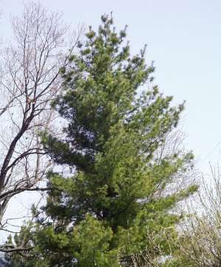
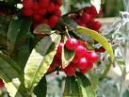
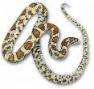
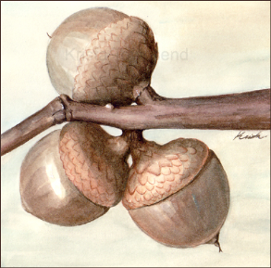
Food webs show the connections between many organisms in an environment.

Slide 6
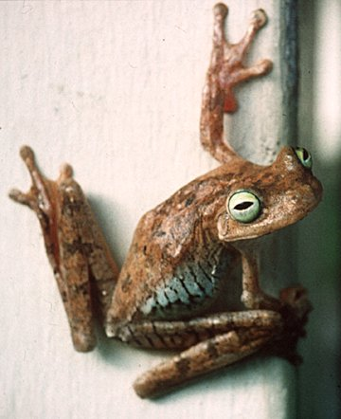
Consumer Pyramid
Primary consumer
Herbivores
Secondary consumer
Feed on primary consumers
(carnivores)
Omnivores
Feed on primary & secondary consumers

Slide 7
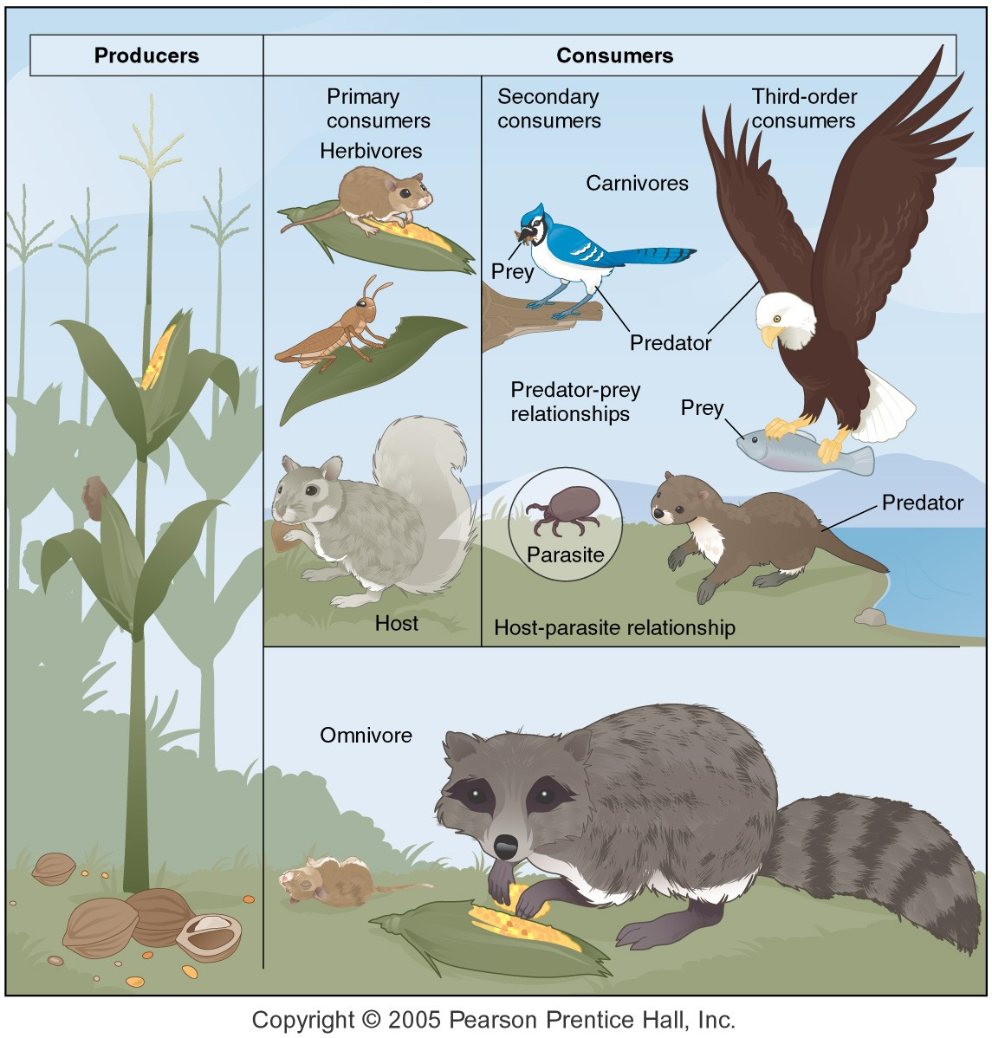
Trophic relationships & food webs

Slide 8
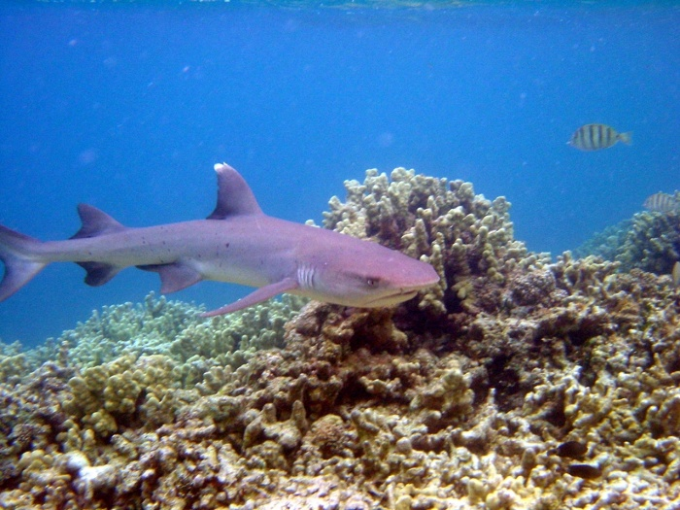
Members of different species of organisms often have to work together, interact and compete in order to survive.

Slide 9
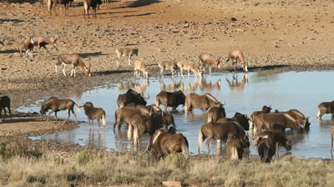
Interspecific Competition
- When two or more species rely on the same limited resource
ex. Antelope, elephants, and water buffalo all require water on the savanna in Africa.

Slide 10
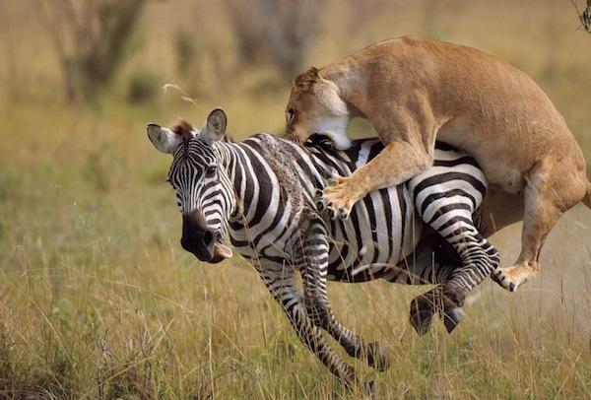
Predator – Prey Relationships
- When one organism hunts another and consumes it.
ex. Lion Vs. Zebra
ex. Shark Vs. Seal

Slide 11
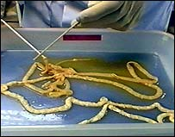
Symbiotic Relationships
- When one organism lives on or in another organism without killing it.
a. Parasitism
- One organism benefits the other is harmed
ex. Tape Worms & People

Slide 12
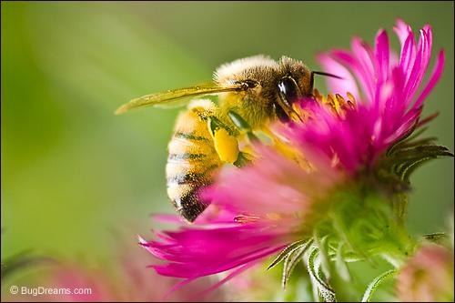
b. Mutualism
- Both organisms benefit from living together.
ex. Bacteria in your Gut
ex. Bees & Flowers

Slide 13
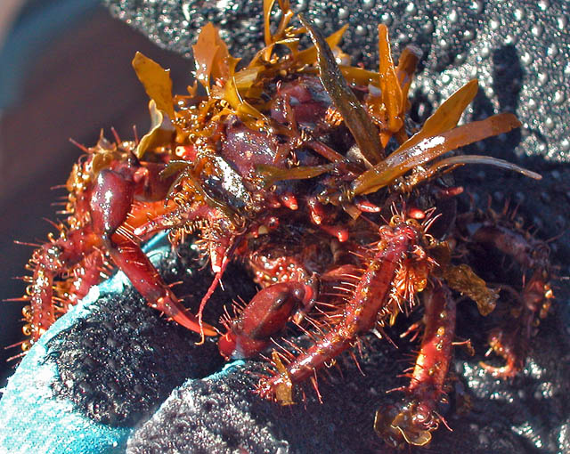
c. Commensalism
- One organism is helped but the other is neither helped nor harmed.
ex. A crab could put seaweed on its shell.
The crab gets camouflaged, the seaweed gets no benefit.

Slide 14
Assignment
Find an example of Parasitism, Commensalism, and Mutualism that could be found in Africa, Asia, or the oceans. Do not use any examples discussed in class.
Explain how each example fits the definition. Write this on the back of your Cornell Notes

Slide 15
Slide Title
Make Effective Presentations
Using Awesome Backgrounds
Engage your Audience
Capture Audience Attention

Slide 16
Slide Title
Make Effective Presentations
Using Awesome Backgrounds
Engage your Audience
Capture Audience Attention

Slide 17
Slide Title
Product A
Product B
Feature 1
Feature 2
Feature 3
Feature 1
Feature 2
Feature 3

