Slide 1
1) Where is the sunniest place in the world?
2) What process allows plants to capture sunlight?
3) What do photovoltaic cells do?
4) What is the major downside of solar power?
5) How can that downside be overcome?

Slide 2
Biomass, Hydroelectric, Solar
Renewable Energy

Slide 3
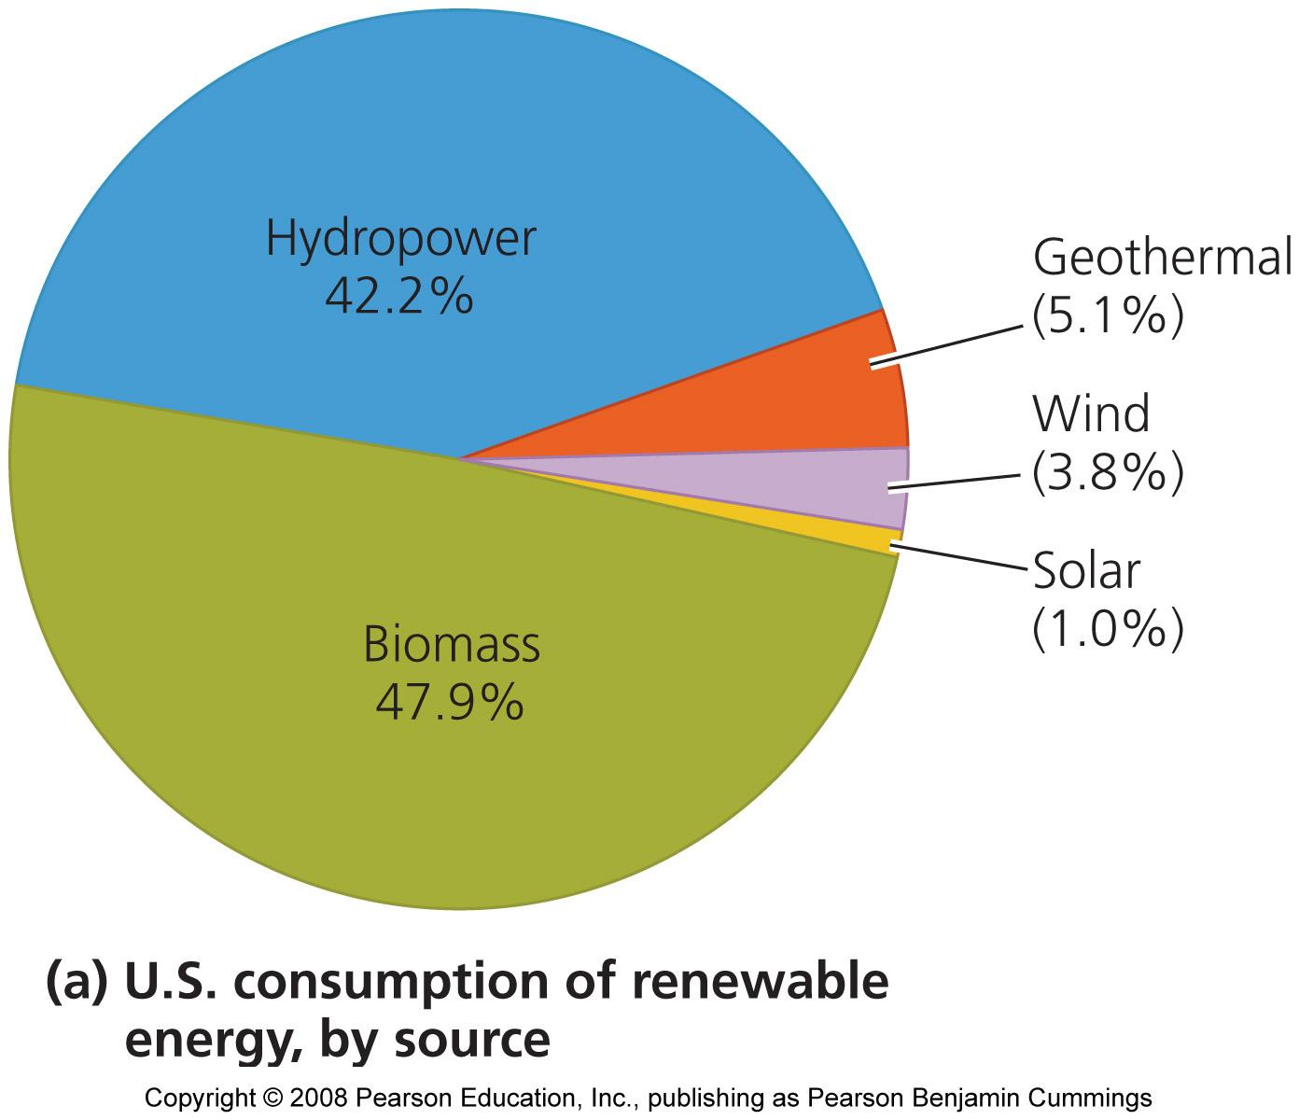
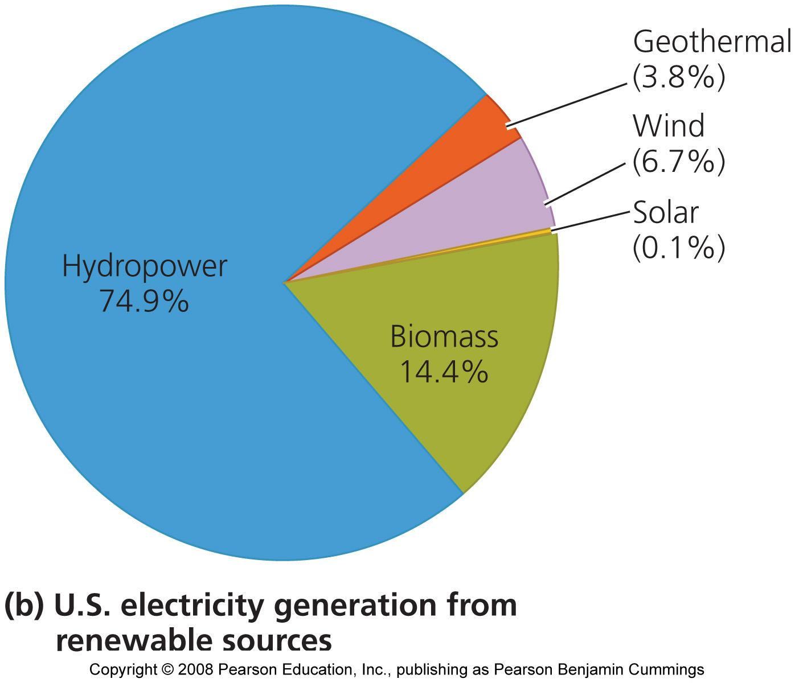
Renewables in USA
We obtain only one half of 1 percent from the new renewable energy sources
Nations and regions vary in the renewable sources they use
In the U.S., most renewable energy comes from hydropower and biomass

Slide 4
Expanded quickly because of:
Growing concerns over diminishing fossil fuels
The environmental impacts of fossil fuel combustion
Advances in technology make it easier and less expensive
Benefits of the new renewables include:
They alleviate air pollution (SO₂, Hg, As) and greenhouse gas emissions (CO₂, CH₄) that can cause climate change
They are inexhaustible, unlike fossil fuels
Help diversify a country’s energy economy
They create jobs and are sources of income and taxes, especially in rural areas
This is important

Slide 5
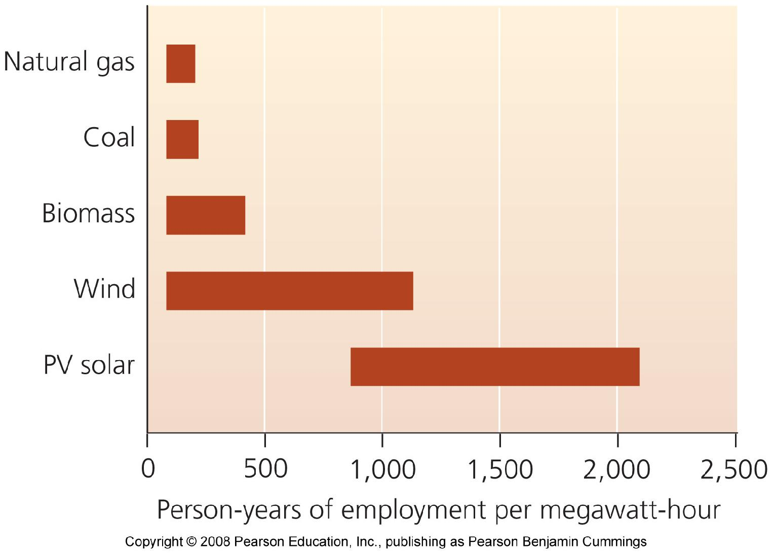
New energy sources create jobs
New technologies require more labor for the same energy
More jobs will be generated than remaining with a fossil fuel economy
Jobs are high technology and high paying.
Economic

Slide 6
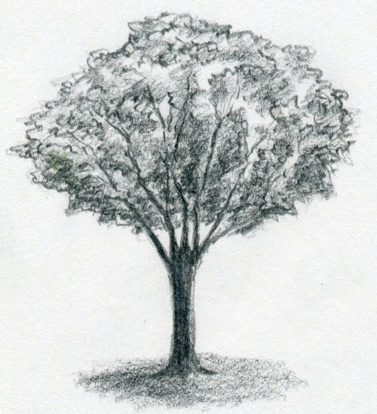
Biomass energy
Biomass energy has great potential for addressing our energy challenges
Biomass = organic material that makes up living organisms
People harness biomass energy from many types of plant matter
Wood from trees, charcoal from burned wood, and matter from agricultural crops, as well as combustible animal waste products

Slide 7
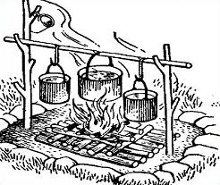
Biomass sources are widely used
More than 1 billion people use wood from trees as their principal energy source
In developing (not developed) nations, families gather fuelwood for heating, cooking, and lighting
Fuelwood and other biomass sources constitute 80% of all renewable energy used worldwide

Slide 8
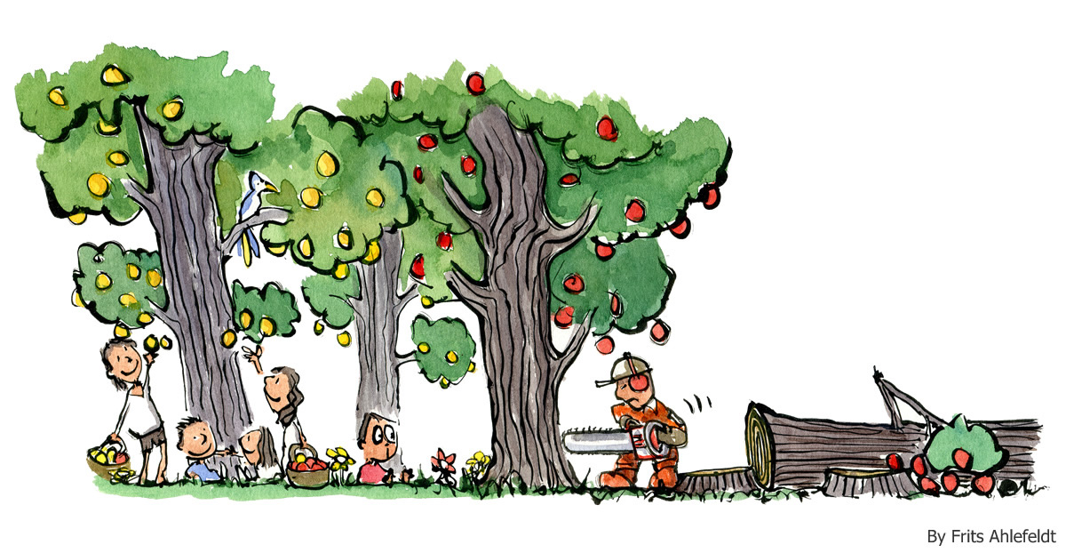
Biomass can be overharvested
Biomass is only renewable when it is not overharvested
With rapid deforestation, soil erosion, and forest failures to regrow, biomass is not replenished

Slide 9
New biomass strategies
Biomass sources include a variety of materials
Biopower = produced when biomass sources are burned in power plants, generating heat and electricity
Biofuels = biomass sources converted into fuels to power automobiles

Slide 10
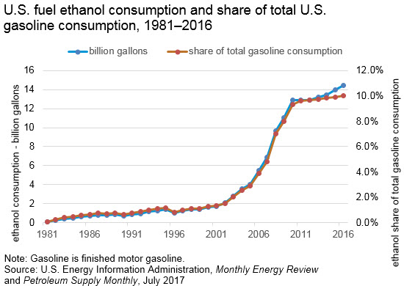
Biofuels can power automobiles
Ethanol = produces as a biofuel by fermenting carbohydrate-rich crops
Ethanol is widely added to U.S. gasoline to reduce emissions
Any vehicle will run well on a 10% ethanol mix (don’t use in lawn equipment though)

Slide 11
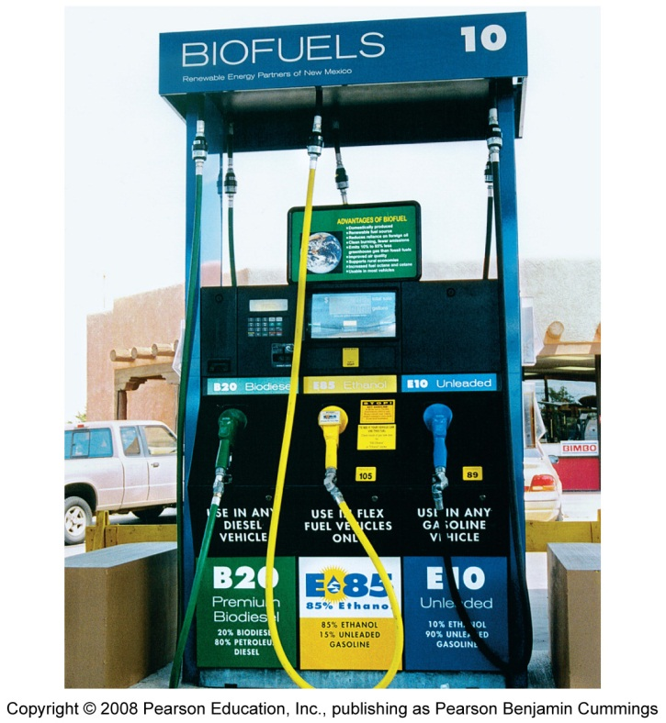
Cars can run on ethanol
Flexible fuel vehicles = run on 85% ethanol
But, very few gas stations offer this fuel

Slide 12
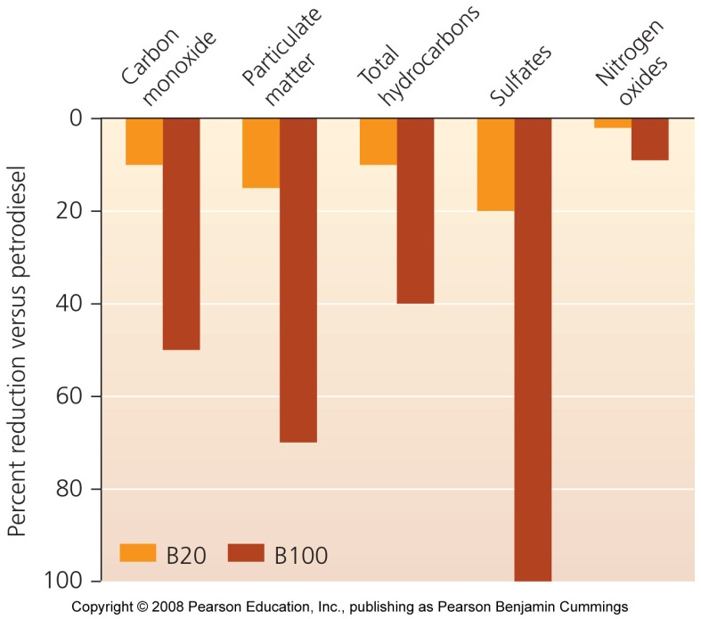
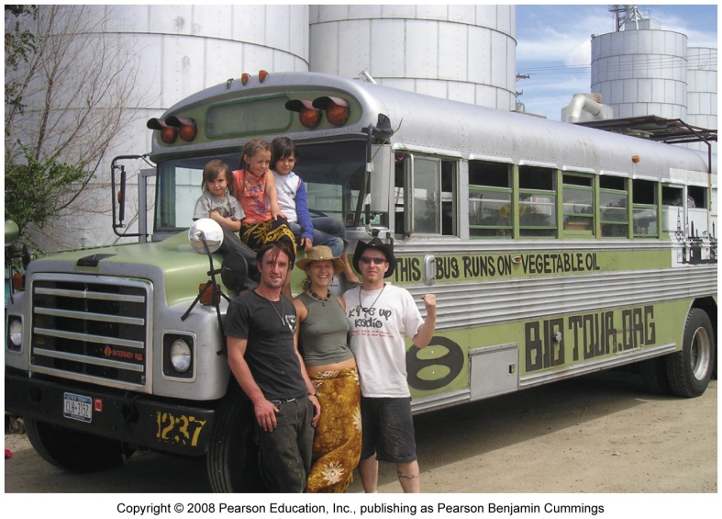
Biodiesel from vegetable oil
U.S. biodiesel producers use soybean oil
Animal fats, used grease, and cooking oil can also be used
Vehicles can run on 100% biodiesel, but the engine needs to be modified
Biodiesel cuts down on emissions; its fuel economy is almost as good and costs slightly more than gasoline

Slide 13
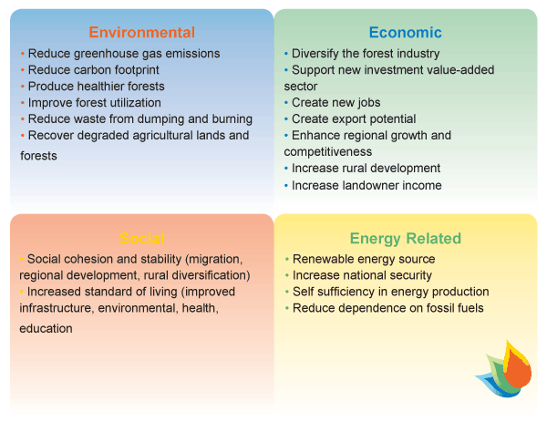
Biomass energy brings BENEFITS
It is essentially carbon-neutral, releasing no new carbon into the atmosphere
Economic benefits include
Supporting rural communities
Reducing dependence on fossil fuel imports
Improved energy efficiency
Reduces air pollutants such as sulfur dioxide

Slide 14
Drawbacks of biomass energy
Health hazards from indoor air pollution
Rapid harvesting can lead to deforestation
Growing crops exerts tremendous impacts on ecosystems
Fertilizers and pesticides
Land is converted to agriculture
Biofuel is competing with food production
Substantial inputs of energy are required

Slide 15
Hydroelectric power
Hydroelectric power = uses moving water to turn turbines and generate electricity
Water passing through the dam turns turbines

Slide 16
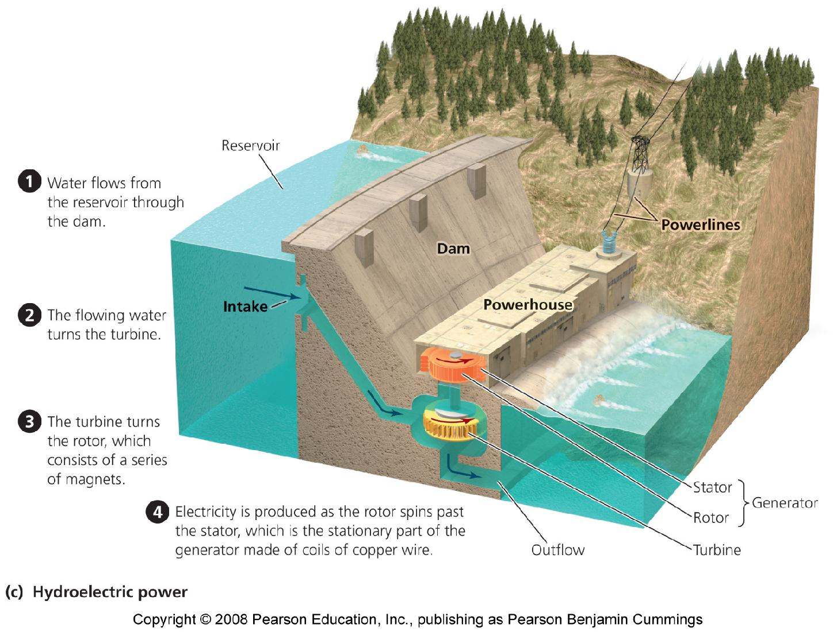
A typical dam

Slide 17
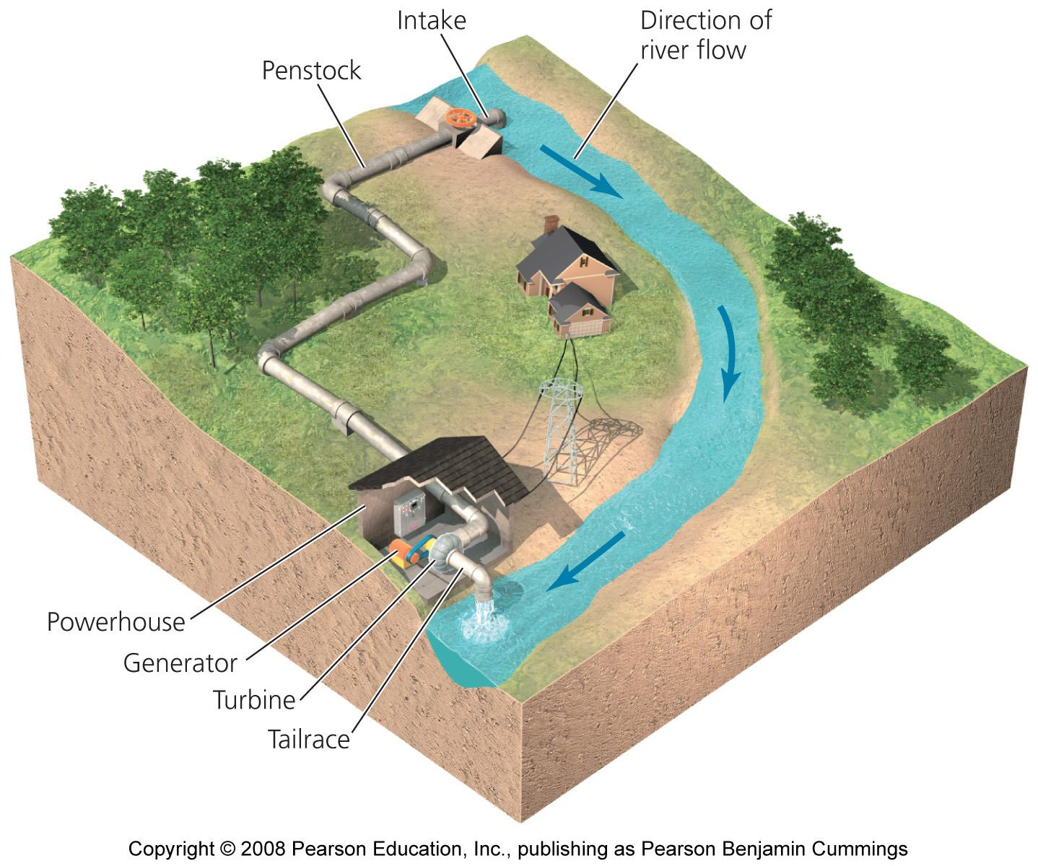
A run-of-river system

Slide 18
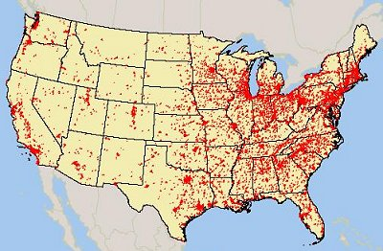
Hydroelectric power is widely used
Hydropower accounts for 2.2% of the world’s energy supply
Nations with large rivers and economic resources have used dams
However, many countries have dammed their large rivers
People want some rivers left undammed

Slide 19
Advantages of Hydroelectric Power
Hydropower has TWO clear advantages over fossil fuels for producing electricity:
It is renewable: as long as precipitation fills rivers we can use water to turn turbines
It is clean: no carbon dioxide is emitted
Hydropower is efficient
It has an EROI (energy return on investment) of 10:1, as high as any modern-day energy source

Slide 20
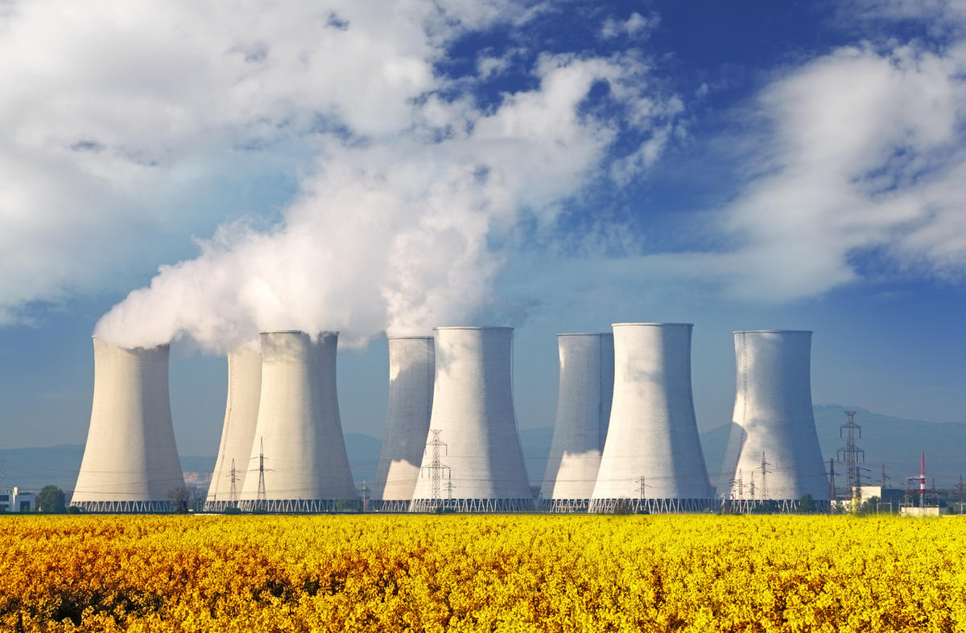
Hydropower has negative impacts
Damming rivers destroys habitats
Upstream areas are submerged
Downstream areas are starved of water
Natural flooding cycles are disrupted
Dams block passage of fish, fragmenting the river and reducing biodiversity

Slide 21
Solar energy
Sun provides energy for almost all biological activity on Earth
Each square meter of Earth receives about 160 watts of solar energy
There is great potential in solar energy
Solar energy has been used for hundreds of years

Slide 22
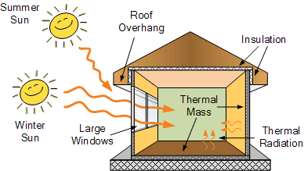
Passive solar
Passive solar uses heat and light from the sun to replace the need for other energy sources.
Low south-facing windows maximize heat in the winter
Planting vegetation in strategic locations
By heating buildings in winter and cooling them in summer, passive solar methods conserve energy and reduce costs
Use of windows to provide indoor lighting.

Slide 23
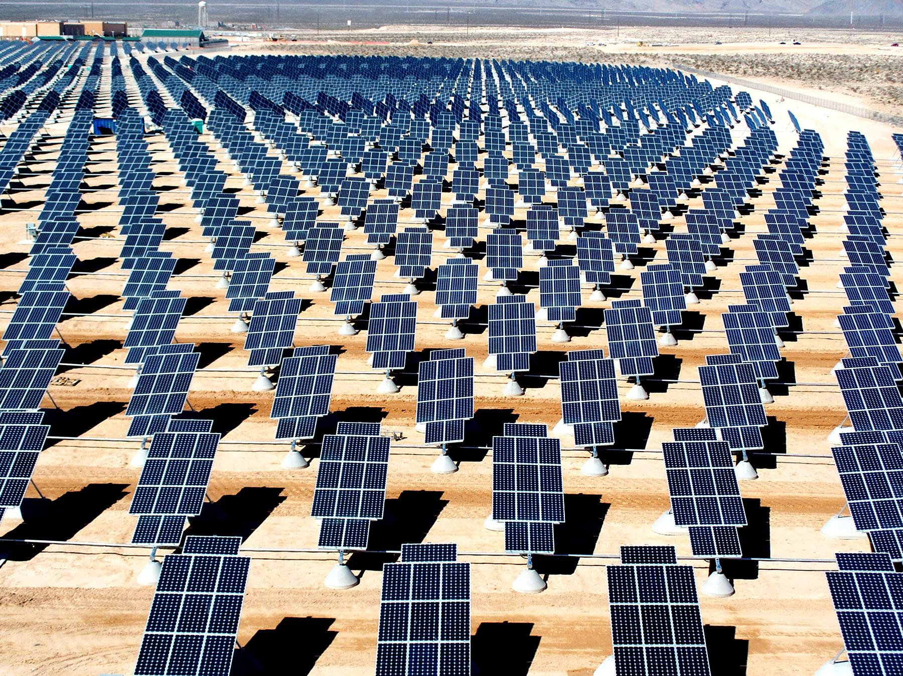
Active solar energy collection
Converts sunlight into another useable form of energy
Converted directly to electricity
Converted and stored as heat

Slide 24
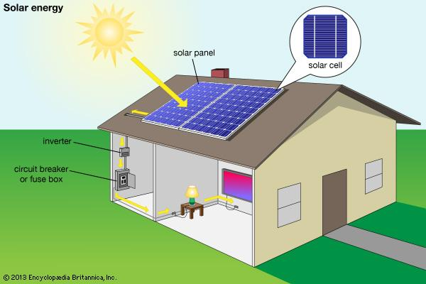
Photovoltaic cells generate electricity
Photovoltaic cells = collect sunlight and convert it into electrical energy
These are what we think of when we hear “solar panel”

Slide 25
A typical photovoltaic cell

Slide 26
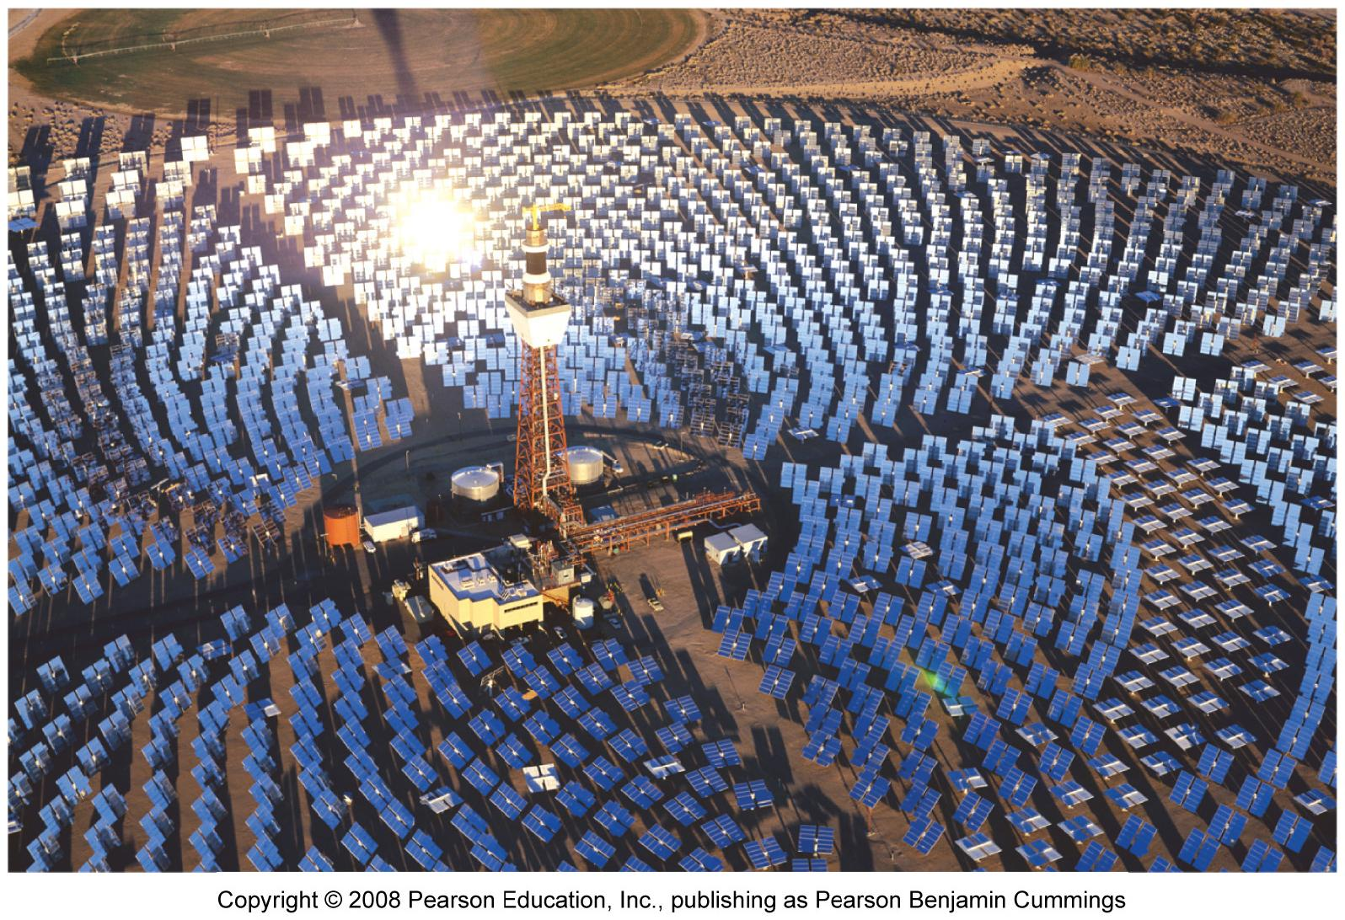
Concentrating solar rays magnifies energy
Focusing solar energy on a single point magnifies its strength
Solar cookers = simple, portable ovens that use reflectors to focus sunlight onto food
Power tower = mirrors concentrate sunlight onto receivers to create electricity
Solar-trough collection systems = mirrors focus sunlight on oil in troughs

Slide 27
Solar power BENEFITS
The Sun will burn for 4 - 5 billion more years
Solar technologies are quiet, safe, use no fuels, contain no moving parts, and require little maintenance
They allow local, decentralized control over power
Developing nations can use solar cookers, instead of gathering firewood
Net metering = PV owners can sell excess electricity to their local power utility
New jobs are being created
Solar power does not emit greenhouse gases and air pollution

Slide 28
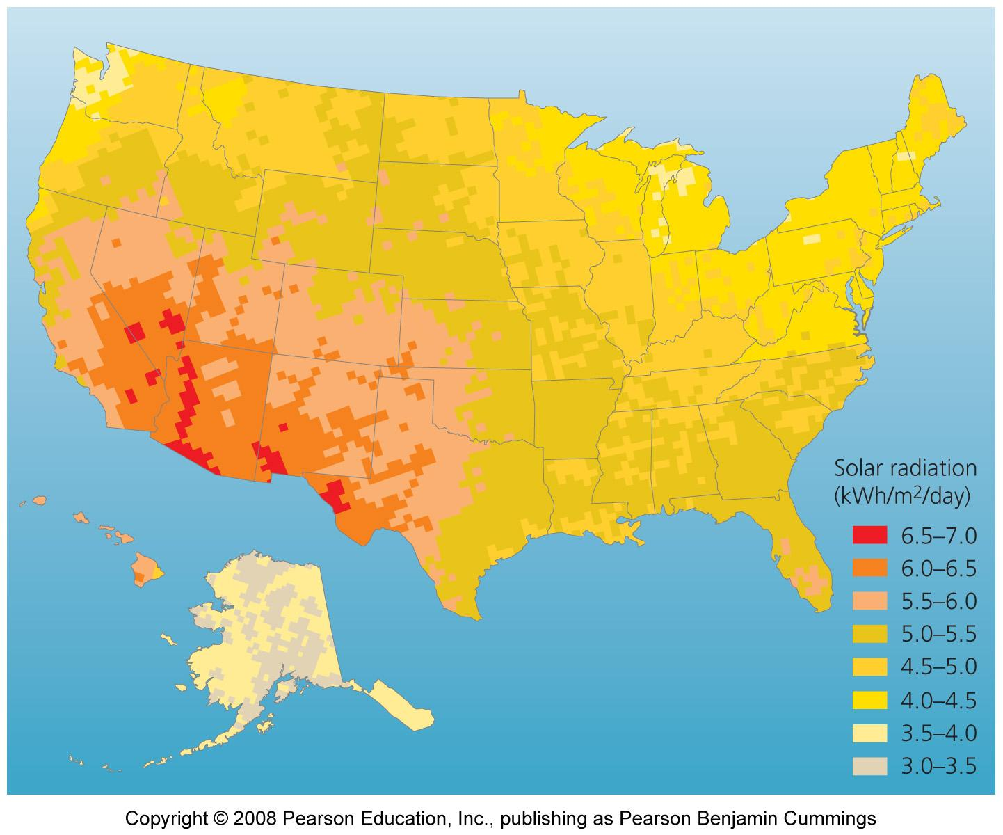
Location Problems
Not all regions are sunny enough to provide enough power, with current technology
Daily and seasonal variation also poses problems

Slide 29
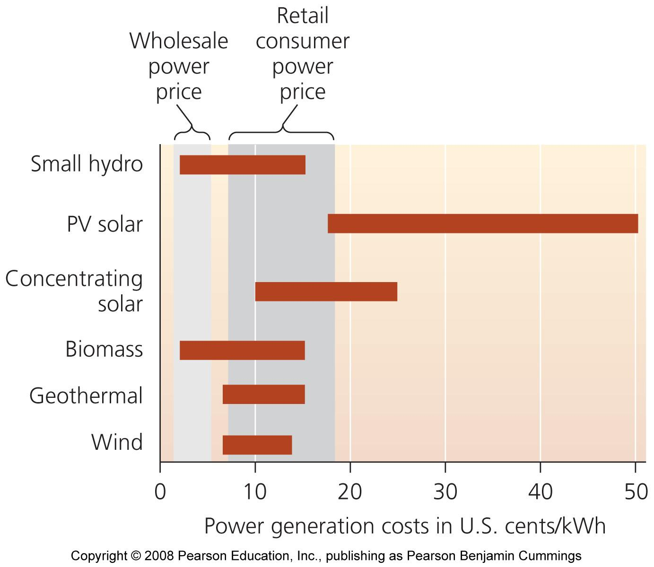
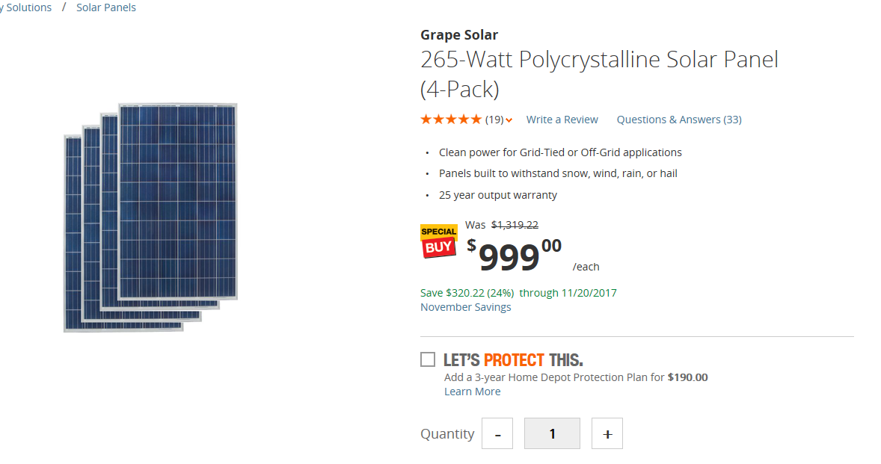
Cost is a drawback
Up-front costs are high and solar power remains the most expensive way to produce electricity
The government has subsidized fossil fuels and nuclear energy at the expense of solar energy

