Slide 1
Day 1: Natural Populations
Unit 5: Human Population

Slide 2
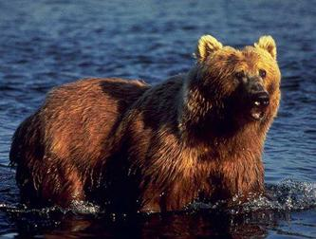
Habitat
A place where a species biologically adapted to live
Defined by the physical environment around the organism

Slide 3
Optimum, Zone of Stress, Limits of Tolerance
Optimum
Ideal habitat and factors for organisms to live the best
Zone of Stress
Factor lowered or raised that the organism is not in optimum.
Organism experiences stress
Limit of Tolerance
Usually is a range of tolerance for each organism
Limit is reached and the organism can no longer survive

Slide 4
Law of Limiting Factors
Any one of several factors being outside the optimal range that will cause stress and limit the growth, reproduction, or even survival of a population

Slide 5
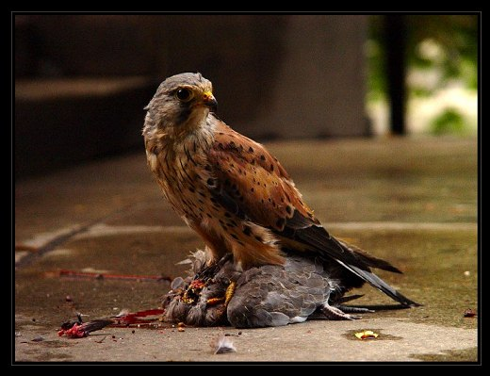
Dynamics of Natural Populations
Each species exists in a population
Over time most species remain more or less constant in size and geographic distribution
Deaths = Births
This balance is called Population equilibrium

Slide 6
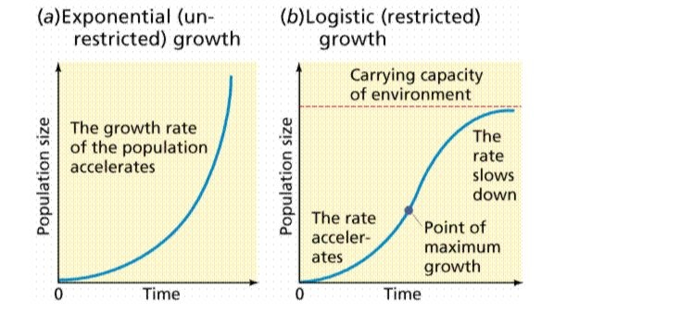
Growth Curves – Two Types J or S
Exponential growth results in population explosion
Called a J-Curve

Slide 7
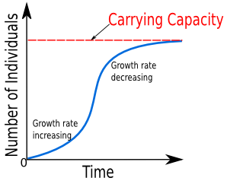
Dynamics of Natural Populations
Population growth curves
Biotic potential (the ability to increase population numbers) versus environmental resistance (the combination of all the biotic and abiotic factors that limit a population’s increase.)
If recruitment is at replacement level, then the population will remain constant.
Growth to the equilibrium point is called an
S-Curve

Slide 8
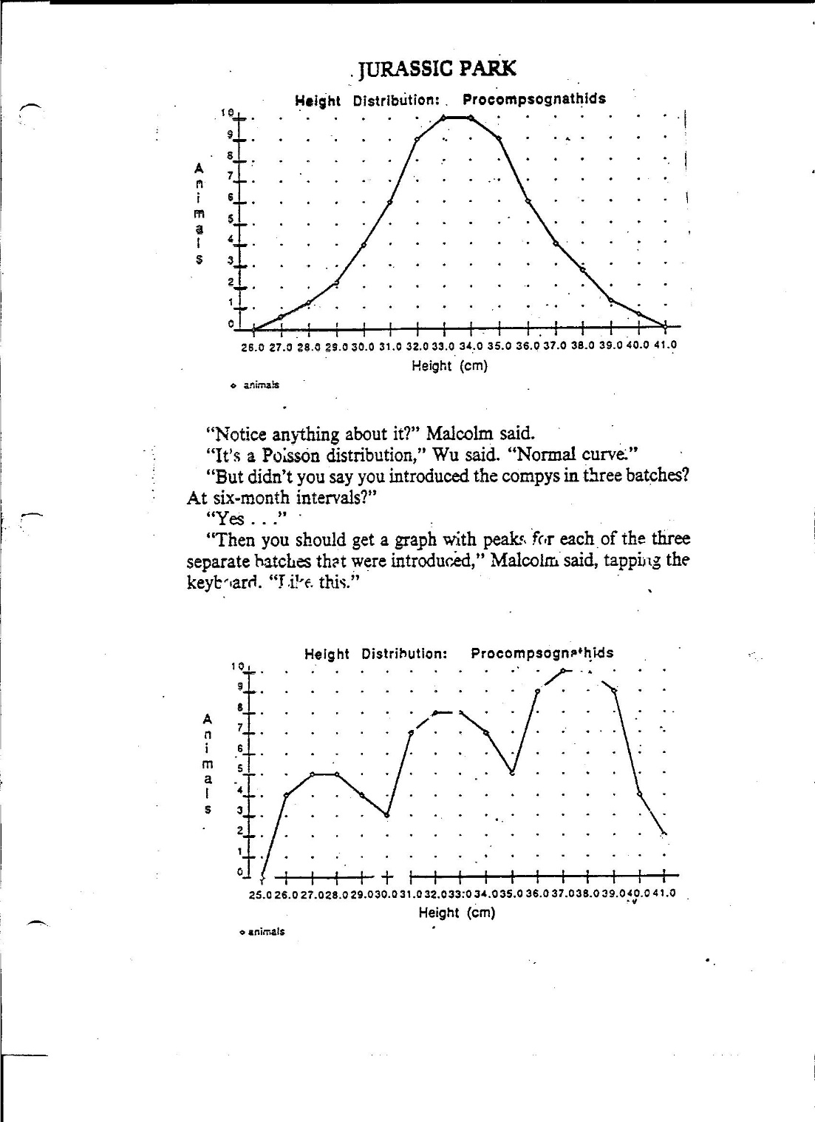

Slide 9
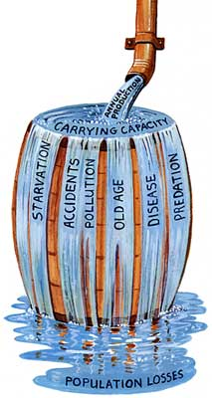
Carrying Capacity
Upper Limit to population number
Maximum population that a given habitat can support without the habitat being degraded over time
(sustainable system)

Slide 10
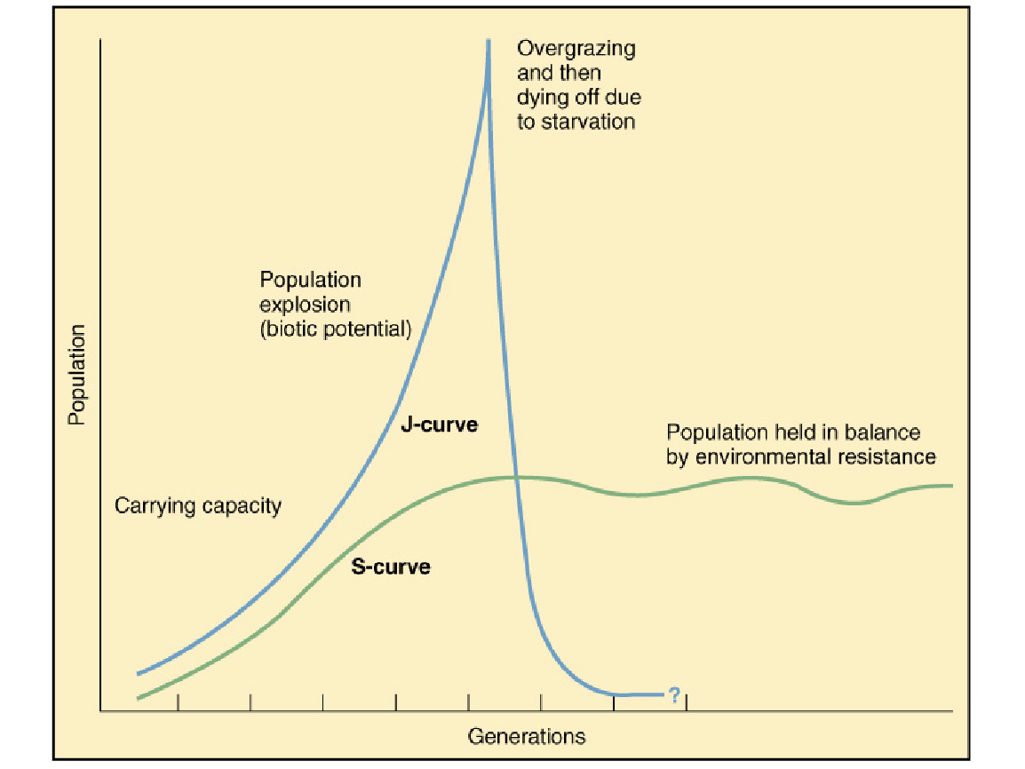

Slide 11
Density Dependence And Critical Number
Environmental resistance factors can be density dependent.
If population density increases, environmental resistance becomes more intense and causes in increase in mortality.
If population density decreases, environmental resistance lessens, allowing the population to recover.
Environmental factors that cause mortality can be density independent
A sudden deep freeze in spring
A fire that may kill all small mammals

Slide 12
Biotic Potential and Environmental Resistance
Biotic Potential
Reproductive rate
Ability to migrate (animals) or disperse (seeds)
Ability to invade new habitats
Defense mechanisms
Ability to cope with adverse conditions
Environmental resistance
Lack of food or nutrients
Lack of water
Lack of suitable habitat
Adverse weather
Predators
Disease
Parasites
Competitors

Slide 14
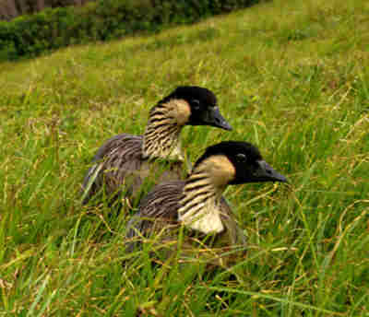
Critical number
The survival and recovery of a population depends on a certain minimum population base (critical number)
If population is depleted below this number surviving members become more vulnerable, breeding fails, and extinction is almost inevitable

Slide 15
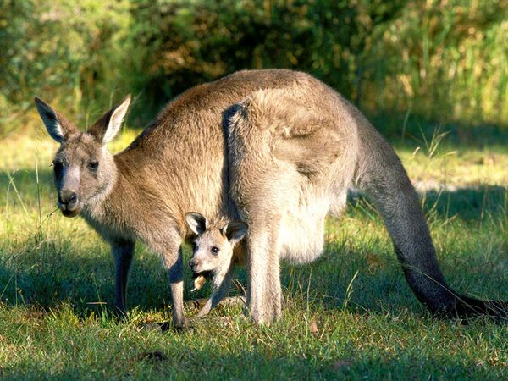
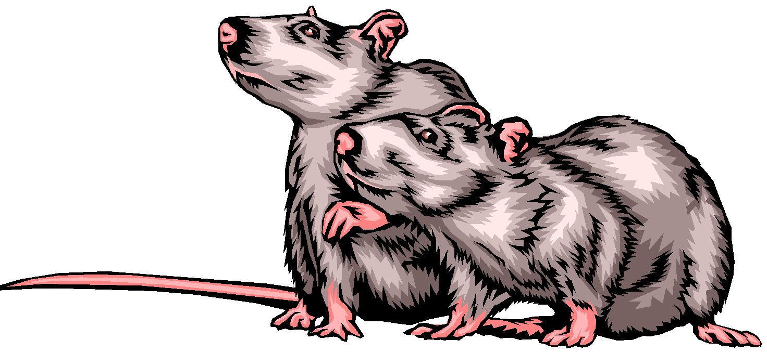
Reproductive Strategies
R Strategists
K Strategists
Reproduce in massive quantities
Leave nature to raise the young
“low recruitment’ = high mortality rate
Favors quickly changing environments
Organisms are usually
Small
Rapid reproductive rate
Short life spans
J – curves
Instinct important
Few offspring
Spend a lot of time nurturing their young
Organisms
Large
Long life spans
S – curves
Learned behavior

Slide 16
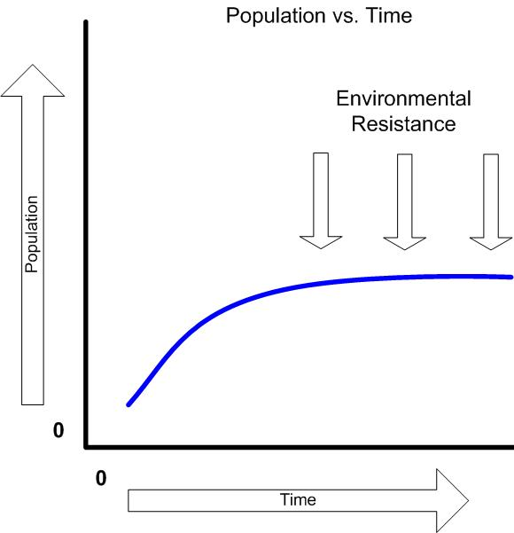
Environmental Resistance
Population explosions seldom occur in nature
Biotic and abiotic factors cause mortality in populations
Biotic factors
Predators
Parasites
Competitors
Abiotic factors
Changes in temperatures
Moisture
Salinity
pH

Slide 17
Density Dependence & Critical Number
The size of a population remains within a certain range when environmental resistance factors are density dependent
As population density (the number of individuals per unit area) increases, environmental resistance becomes more intense and causes an increase in mortality, resulting in the population decreasing.

Slide 19
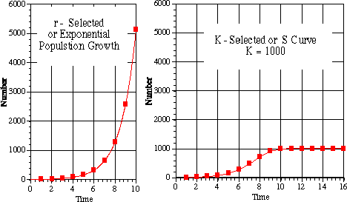
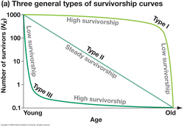

Slide 21
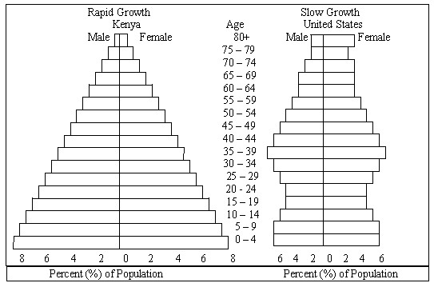

Slide 22
K Strategist
R Strategist

Slide 23
Write your own definition for the following 3 words:
Competition
Carrying Capacity
Population equilibrium

Slide 24
1) What are 2 biotic and 2 abiotic factors that naturally (with no people around) keep the population of deer from growing out of control? Be specific.
2) When humans move into an area the population of deer tends to explode upwards. How do you think humans change the population limits of the deer?

Slide 25
In some sense one of the greatest losses of all is that deer are no longer viewed as the majestic and even mystical animals of the forest that they were only a few decades ago. To quote Bloomberg: “… it’s hard to think of a more insidious threat to forests, farms and wildlife, not to mention human health and safety, than deer.”

Slide 26
John Muir: Who is he?
How different that is from the time of John Muir, who wrote, “Standing, lying down, walking, feeding, running even for its life, it [deer] is always invincibly graceful, and adds beauty and animation to every landscape — a charming animal and a great credit to nature.”

