Slide 1
Catalyst: Tuesday, 9/5/2017
You Got This!!!!!!!!

Slide 2
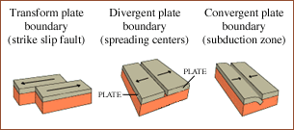
Catalyst: Tuesday, 9/5/2017
Draw this!

Slide 3
Catalyst: Wednesday, 9/6/2017
What are the symbols for platinum, gold and silver?

Slide 4
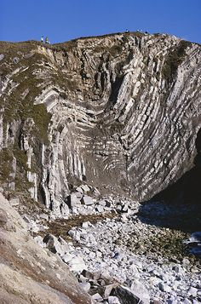
Catalyst: Wednesday, 9/6/2017
Upward folding of rock strata: __________

Slide 5
Catalyst: Thursday, 9/6/2017
What are the symbols for tin, uranium, and lead?

Slide 6
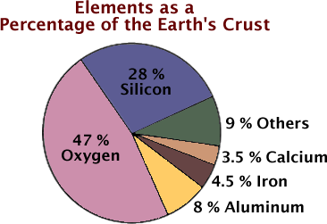
Catalyst: Thursday, 9/7/2017
Sketch the pie chart and label

Slide 7
Catalyst: Friday, 9/8/2017
The Riddle-R
How can you physically stand behind your friend as he physically stands behind you?

Slide 8
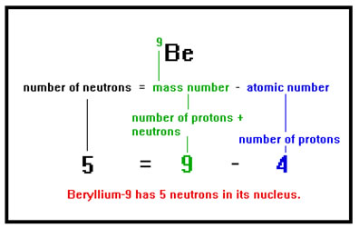
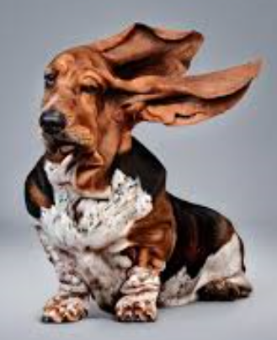
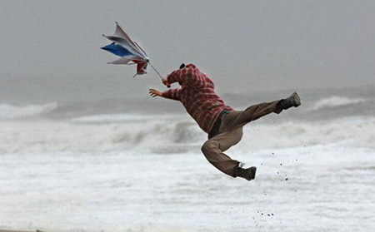
Catalyst: Wednesday, 9/13/2017
How many neutrons does C-12 have? C-14?

Slide 9
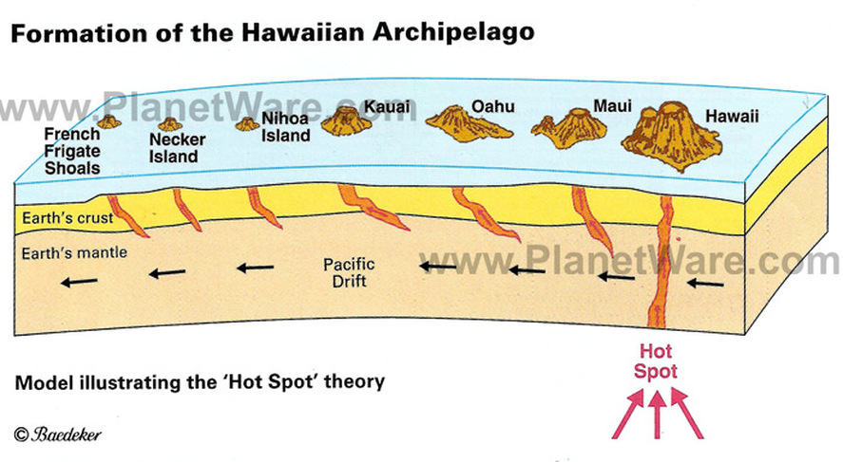
Catalyst: Wednesday, 9/13/2017
How was Hawaii formed?

Slide 10
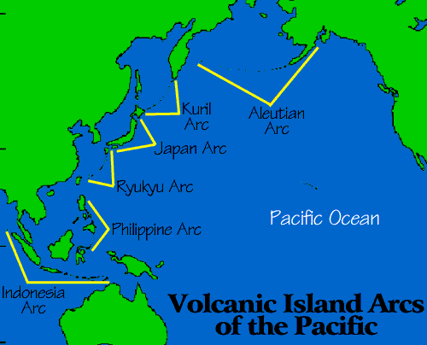

Slide 11
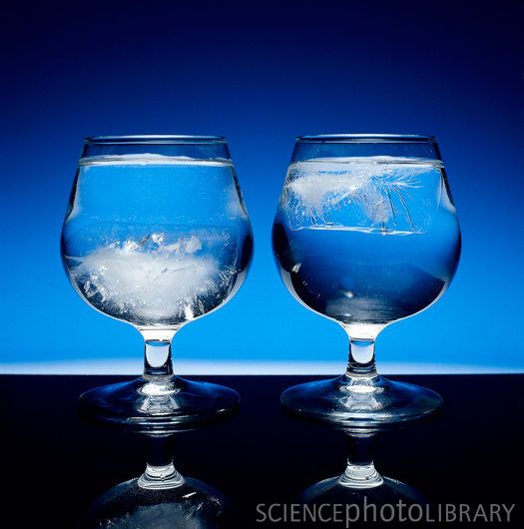
Catalyst: Thursday, 9/14/2017
Ice cubes float in one glass of water but not the other glass. Why?
How many neutrons does H-1 have? H-2? H-3? What are their names?

Slide 12
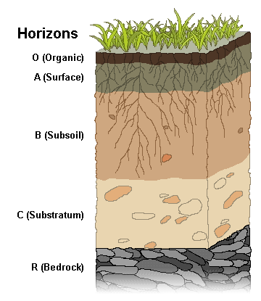
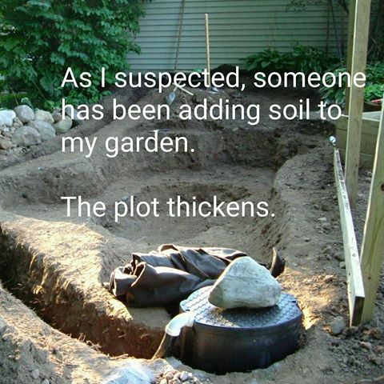
Catalyst: Thursday, 9/14/2017
Sketch the Soil Horizon

Slide 13
Catalyst: Friday, 9/15/2017
How smart are you?

Slide 14
