Slide 1
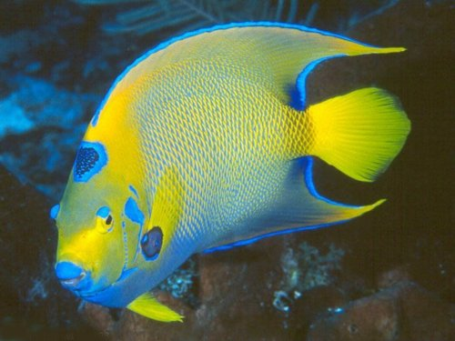
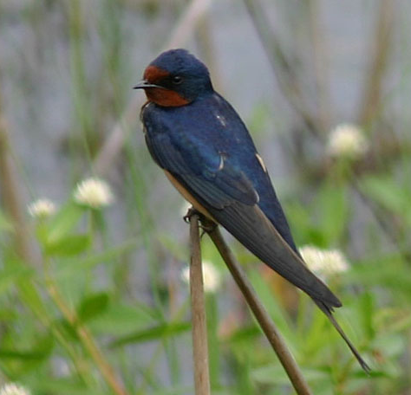
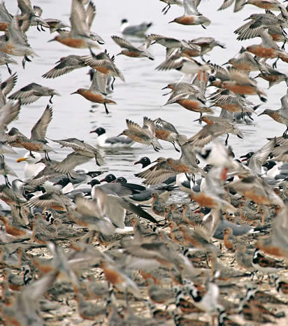
Population Dynamics

Slide 2
Population Size
4
Four variables that govern population size:
Births
Deaths
Immigration
Emigration
Population change = [ births + immigrations ] - [ deaths + emigration ]

Slide 3
Population Size
Population size is determined by the interplay between it biotic potential and environmental resistance.
Biotic Potential - capacity of a population for growth
Environmental Resistance - all the factors acting jointly to limit the growth of a population

Slide 4
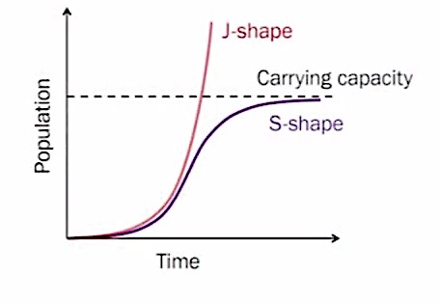
Logistic and Exponential
Logistic Growth - involves exponential growth when a population is small and a steady decrease in growth in time as the population approaches the carrying capacity
S-shaped curve
Exponential Growth - a population that does not have resource limitations
J-shaped curve

Slide 5
Carrying Capacity
Carrying Capacity (K) - the number of individuals of a given species that can be sustained indefinitely in a given space; determined by biotic potential and environmental resistance.

Slide 6
Zero Population Growth
ZPG
when births plus immigration equal deaths plus emigration

Slide 7
K-Strategist and r-Strategist
K-Strategist Species (competitor) - reproduce late, have few offspring with long generation times (K)
have big bodies, live for a long time, spend little of their energy on reproduction
tend to do well in competitive conditions when pop. is near carrying capacity
prone to extinction
r-Strategist Species (opportunist) - species with a high intrinsic rate of increase (r)
Many small and unprotected young
Most die before reaching reproductive age

Slide 8
Doubling Time
the time it takes for a population to double
Rule of 70
= number of years to double
70/GROWTH RATE

Slide 9
Crude Birth Rate and Crude Death Rate
Crude Birth Rate (CBR) - number of live births per 1000 people in a population in a given year
Crude Death Rate (CDR) - number of deaths per 1000 people in a population in a given year

Slide 10
Ten Years Ago….
2000 World Census
Average crude birth rate – 22
Average crude death rate - 9
Rate of World's Population Change (%) = (Birth Rate - Death Rate)/1000 people x 100
= (CBR - CDR)/10
1.3% Population growth

Slide 11
Global Fertility Rate
There are two types of fertility rates
1. Total Fertility Rate (TFR)
TFR is an estimate of the average number of children a woman will have during here childbearing years under current age-specific birth rates.
2. Replacement Level Fertility
This is the number of children a couple must bear to replace themselves.(2.1 in developed countries and 2.5 in developing countries). These numbers are greater than 2 because some female children die before reaching their reproductive years.

Slide 12
Age Structure Diagram
Age Structure Diagrams - show the proportion of the population at each age level.
Three main age categories:
pre-reproductive (ages 0-14)
reproductive (15-44)
post-reproductive (45+)

Slide 13
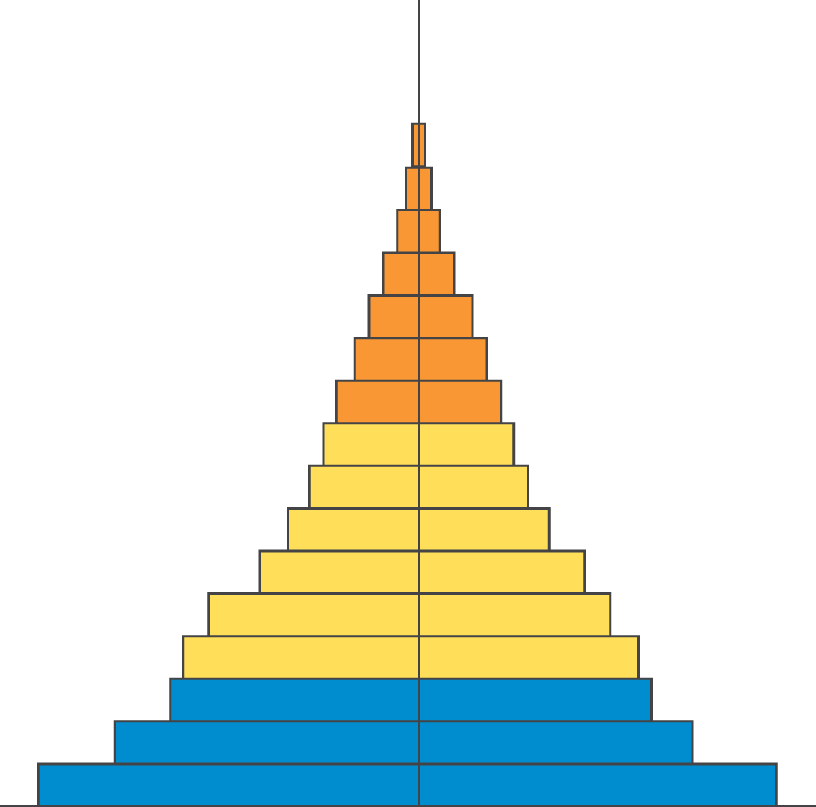
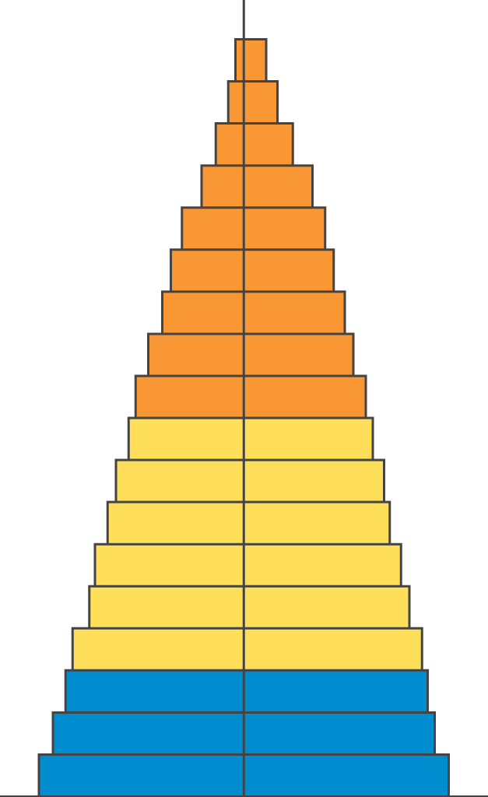
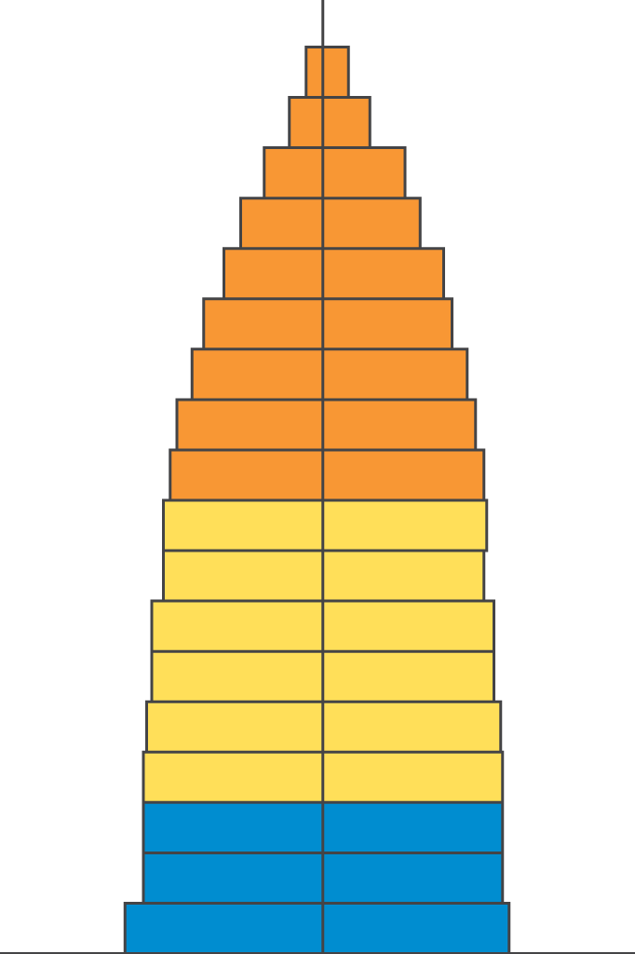
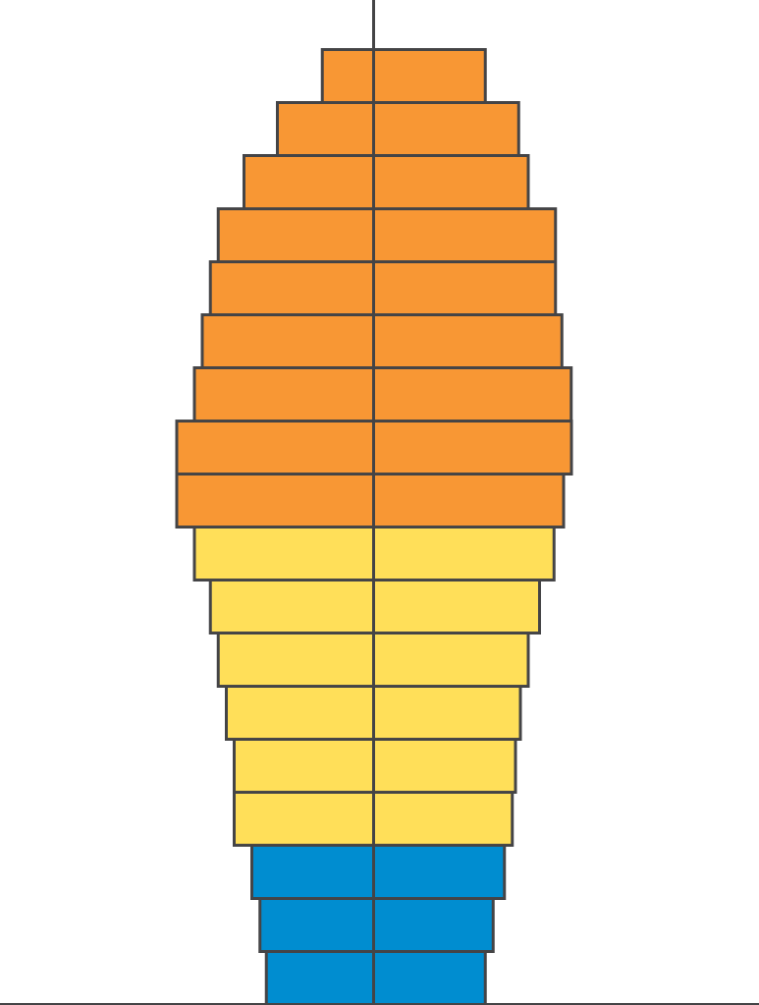
Age Structure Diagrams
Male
Female
Rapid Growth
Guatemala
Nigeria
Saudi Arabia
Slow Growth
United States
Australia
Canada
Zero Growth
Spain
Austria
Greece
Negative Growth
Germany
Bulgaria
Sweden
Ages 0-14
Ages 15-44
Ages 45-85+

Slide 14
Demographic Transition
Demographic Transition: As countries become more industrialized, first their death rates and then their birth rates decline.
This Transition takes place in four stages:
pre-industrial stage - harsh living conditions, high infant mortality rates, high death rate; need a high birth rate .. pop. growth is small (or zero)
transitional stage - industrialization begins, rise in food production, improved health care, reduction in death rate, birth rate remains high .. pop. grows rapidly (2.5-3%/year)

Slide 15
Demographic Transition(cont.)
industrial stage - industrialization is widespread. Birth rate drops and approaches the death rate. Better access to birth control, reduced infant mortality, incr. job opportunities for women, high cost of raising children, HS and college educations. Pop. grows but at a slower rate.
postindustrial stage - Birth rate declines further, equals death rate ==> ZPG.

Slide 16
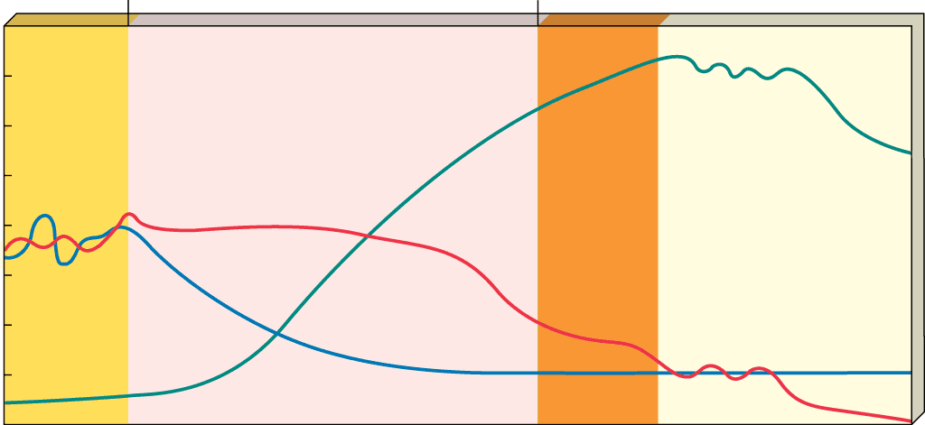
Demographic Transition
Stage 1
Preindustrial
Stage 2
Transindustrial
Stage 3
Industrial
Stage 4
Postindustrial
80
High
70
60
Birth rate
50
Birth rate and death rate
(number per 1,000 per year)
40
Relative population size
30
Death rate
20
10
Total population
0
Low
Low
growth rate
Increasing Growth
growth rate
Very high
growth rate
Decreasing
growth rate
Low
growth rate
Zero
growth rate
Negative
growth rate
Time

